Slide 1


Ministry of Higher Education, Science and Innovations
PRIORITIES OF HIGHER EDUCATION DEVELOPMENT IN UZBEKISTAN
Ministry of Higher Education, Science and Innovations
Republic of Uzbekistan
Tashkent 2023

Slide 2

HIGHER EDUCATION INSTITUTIONS (HEI) OF UZBEKISTAN
OVERALL NUMBER OF HIGHER EDUCATION INSTITUTIONS (HEIs) – 211
NON-PUBLIC AND FOREIGN HEIs – 95
Tashkent (capital city)
90
Other regions
121
HEIs under the MHESI
63
- including branches
8
Number of public HEIs 116
Number of non-public HEIs 65
Number of foreign HEIs 30

Slide 3
UZBEKISTAN HIGHER EDUCATION IN FIGURES
ACADEMIC POTENTIAL
FACULTY 39 533
DSc, professors
3 074
PhD, associate professors
12 579
Assistants
23 808
Academic potential, %
ENROLLMENT RATE IN HIGHER EDUCATION
STUDENTS 1 222 246
BACHELOR
1 090 329
BACHELOR DEGREE
MASTER DEGREE
Full-time (day-time)
602 092
Part-time
436 531
Evening tuition
51 706
MASTER
31 897
Enrollment rate, %

Slide 4

SOCIAL PROTECTION
Additional admission for academic year 2022/2023 based on priveleges
For applicants with disabilities, admission parameters based on an additional state grant of 2 percent compared to the general admission parameters have been established.
Total
160
government scholarship
Admission parameters based on an additional state grant of 1 percent compared to the general admission parameters for orphans have been established.
87
tuition fee
73
An additional 2,000 state grants were allocated for women.
Additional admission indicators in higher education institutions
For women who have 5 years of work experience, but do not have higher education, 500 additional admission quotas on the basis of basic payment contract have been allocated annually.
For persons with disabilities
Total
23 604
government scholarship
The amount of the tuition fee of the women admitted to the studentship on the basis of the basic fee-contract within the parameters of admission to the master's degree is covered by the state budget funds.
15 344
tuition fee
8 260

Slide 5
ENSURING THE QUALITY ASSURANCE IN HIGHER EDUCATION
A road map was developed in 110 higher education institutions to improve the quality of education and improve the social and spiritual environment
Prepared for international accreditation - 6 higher education institutions
International conferences were held – 2
Forum on "Improving the quality assurance system in higher education“ Conference on "Role of quality of education in economic transformation of society"
Monitoring of the quality of education based on risk analysis was introduced in higher education institutions.
Roundtable discussion on "Problems of improving the quality of higher education based on European standards“
Criteria and indicators for determining the quality assurance in higher education institutions were developed

Slide 6
IMPROVING THE EDUCATIONAL PROCESS AND DOCUMENTS
Applications from a total of 2,064 students who expressed their desire to transfer their studies due to valid reasons were accepted until January 20, 2023. Applications were fully reviewed and a total of 1,779 students were approved for transfer.
In order to improve the quality of the educational process, Coordinating Councils were established in the fields of higher education
A branch council on professional qualifications and knowledge in the field of education was established and its composition was approved
The level of equipment with laboratories was studied
The list of national or equivalent international certificates for participation in contests for master's and post-higher education specializations has been updated
Educational laboratory kits available in 76 higher education institutions
4,962 are usable
321 are unusable
There is a need to purchase 5,615 laboratory kits
The draft order the state standard of the Republic of Uzbekistan "State educational standard of higher education, classification of higher education directions and specialties" was developed
The level of provision of laboratory kits of HEIs is on average 69 percent

Slide 7

Ministry of Higher Education, Science and Innovations
PRIORITY GOALS: 2030 HE DEVELOPMENT CONCEPT
Expansion of access to HE (support to vulnerable groups of population)
HE Enrollment rate – 40 % (Target by 2026 – 50%)
New models of Quality Assurance (University driven quality self-assessment)
Ensuring the academic independence of HEI
Research-intensive universities with a focus on the transfer of technologies
Internationalization agenda (Education "hub" of Central Asia)
Ensuring financial sustainability of HEI through financial autonomy
Implementation of the "University 4.0" concept

Slide 8

Improvement of the regulatory legal base of science and innovative activities
A total of 88 regulatory legal documents were adopted:
2
28
6
38
12
2
Laws of the Republic
of Uzbekistan
Resolutions of the President of the Republic of Uzbekistan
Decrees of the President of the Republic of Uzbekistan
Resolutions of the
Cabinet of Ministers
Orders of the
Cabinet of Ministers
Draft of new normative documents
“On science and scientific activity”
Start-up laws
“On innovative activity”
“Strategy for the development of artificial intelligence in the Republic of Uzbekistan”
The strategy of Innovative development of the
Republic of Uzbekistan in 2022-2026 was adopted.

Slide 9


















































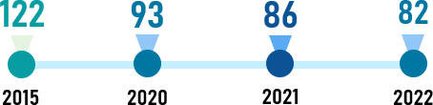








The project of innovative development strategy of the Republic of Uzbekistan until 2030
Main purpose of strategy
Development of the continuous (cyclical) innovation ecosystem "Innovation-capital-innovation"
Expected Results
Strategic directions
Formation of creativity, innovation entrepreneurship and rationalization abilities in youth
Creating new jobs based on “radically innovative” innovations
Further development of human capital in the management of innovative activities
Formation of
National innovation infrastructure
Securing ownership rights in the cyclical
process of “innovation-capital-innovation”
Encouraging demand for innovation
Ensuring rapid socio-economic growth of
regions
Increasing the number of small and medium business companies and start-ups formed on the basis of “radically innovative” innovations
Organization of innovation clusters and large enterprises
Formation of a system of reorientation of the created capital to "radically renewing" innovations
Development of support infrastructure for start-up initiatives
increase the level of commercialization of the “effective” innovation initiators
Establishment of academic "spin-off" companies
Increasing the share of innovative active
enterprises
Organization of large-scale efficient production (capital creation).
TARGET INDICATORS to be implemented by 2030:
THE GOAL TO BE ACHIEVED IN THE GLOBAL INNOVATION INDEX RATING
Number of new interactive educational programs to be implemented in OTM
7
25
Number of scientific developments commercialized in domestic and foreign markets
150
400
613
4500
Entrance to the “Top 50 Countries” on Global Innovation Index by 2030
Number of graduators in bachelor’s and ₁₈₀
master’s degree in innovation management
sphere at the Higher Education Institution 720
0,2
2
6
45
The number of innovative active business entities compared to the total number of industrial production enterprises
Domestic expenditure on development and research in relation to the total volume of GDP (%)
The number of infrastructure objects of
innovative activity
25
85
New jobs created as a result of innovative entrepreneurship (thousands)
The volume of private sector investments in development and research (billion soums)
28
150

Slide 10
















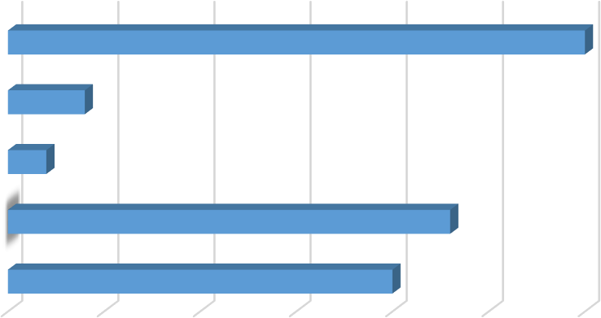





Scientific projects within the framework of the state order for scientific research works
643 scientific projects with a total value of 904.1 billion soums are being implemented
Fundamental
180,0 billion soums worth of 57 projects
Practical
478,8 billion soums worth
361 projects
Innovative
153,9 billion soums worth
143 projects
Equipping with laboratory equipment
2018-2020 years. – 96,5 billion soum worth
123 types
2021 y. – 82,9 billion soum worth, 206 types
86 projects were
complemented
Distribution of ongoing projects by subject areas
Commercialization of 47 projects has started, 39 projects are being prepared for commercialization
200
180
160
¹⁴⁰ 119.6
120
100
80
60
40
20
0
178.9
Number of projects Allocated fund (billion soum)
157.3 157.4
practical – 29,
innovative – 36,
foreign – 21
132
102
88
93 92.1
76.5
79
62.9
52
57
Important scientific results:
Flotoreogen, ceramic pigments, ozone generator, anti-cancer drug - "Biokor", nanomaterials, S-6602 type of cotton, combined cotton picking machine, retailing machine, "Semurg cluster"
Chemistry
Biology
Agriculture
Technics
Medicine and farmaceuticals
Social subjects
International projects
6
Ongoing International
Contests:
Important scientific results
Germany, Japan, China,
Turkey,
1
Number of articles in scientific journals included in WoS
and Scopus databases
1709
79 international joint scientific projects are being implemented (80.9 billion soums)
Number of articles published in international scientific journals and conferences
(except WoS and Scopus journals)
2
6599
Беларусь
30
Туркия
4
3
Number of published monographs
579
Belarus, | 4 | Number of patents obtained | 305
Hungary | 5 | Number of licenses for the software product | 300
Россия
2
Expected results
6
Number of patent applications submitted
432
Ҳиндист…
23
Хитой
20
Together with foreign scientists following modern technologies will be created: big data technologies, the Aral Bay problem, artificial intelligence, anti-salinity technologies, use of water resources, soil fertility improvement, etc.
0
5
10
15
20
25
30

Slide 11
THANK YOU FOR YOUR ATTENTION!

