Slide 1
Development of the targeted Educational program for Bachelors in Solar Energy in Uzbekistan
101128871 — DEBSEUz — ERASMUS-EDU-2023-CBHE
Introduction to Politecnico di Torino

Slide 2
Outline
Development of the targeted Educational program for Bachelors in Solar Energy in Uzbekistan
101128871 — DEBSEUz — ERASMUS-EDU-2023-CBHE
Introduction to PoliTO
Role in the project and key staff
Experience in previous capacity building project
Research of team staff

Slide 3
Introduction to PoliTO
Development of the targeted Educational program for Bachelors in Solar Energy in Uzbekistan
101128871 — DEBSEUz — ERASMUS-EDU-2023-CBHE
Technical School
for Engineers
1859
1862
Italian Industry
Museum
Regio Politecnico di Torino
1906
1958
Corso Duca degli Abruzzi:
Campus opening
160 years of
Polytechnic Culture
2019

Slide 4
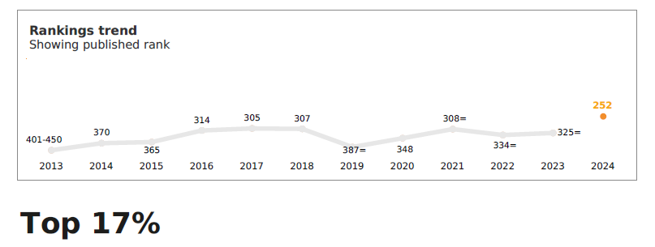
Introduction to PoliTO
Development of the targeted Educational program for Bachelors in Solar Energy in Uzbekistan
101128871 — DEBSEUz — ERASMUS-EDU-2023-CBHE
QS World University Ranking
Overall ranking|World 2024
252 of 1500 Politecnico di Torino Top 17% globally
by Broad Subject|World 2023 45 Engineering and Technology
by Subject 2023
28 Architecture / Built Environment
51-100 Art & Design
101 Computer Science & Information Systems
63 Chemical Engineering
33 Civil and Structural Engineering
38 Electrical & Electronic Engineering
26 Mechanical, Aeronautical & Manufacturing Engineering 46 Mineral & Mining Engineering
59 Material Science 98 Mathematics 15 Petroleum Engineering

Slide 5
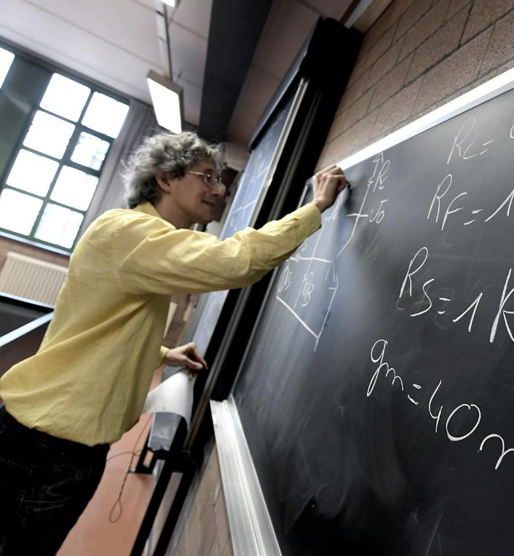
Introduction to PoliTO
Development of the targeted Educational program for Bachelors in Solar Energy in Uzbekistan
101128871 — DEBSEUz — ERASMUS-EDU-2023-CBHE
Human Capital
up to 31 December 2022
334
Full professors
Associate professors
Researchers
Female population
434
346
30%
Administrative staff
914
Technical, administrative, librarian staff
Female population
61%

Slide 6
Introduction to PoliTO
Development of the targeted Educational program for Bachelors in Solar Energy in Uzbekistan
101128871 — DEBSEUz — ERASMUS-EDU-2023-CBHE
2022 Balance Sheet
188 421 488 €
MUR funds
31 742 035 €
Tuition fees
26 094 427 € UE and international research funds
26 282 237 € Research contracts and technology transfer
14 958 412 € Other contributions (except MUR)
12 791 504 € Other funds and revenues
5 366 759 € Regional and local research funds
3 358 636 € Research funds from other organisations
8 178 167 € Research funds from MUR and other Ministries
317 Million EUR
5%
2%
1%
%
4%
5%
8%
8%
59%
10%

Slide 7
Introduction to PoliTO
Development of the targeted Educational program for Bachelors in Solar Energy in Uzbekistan
101128871 — DEBSEUz — ERASMUS-EDU-2023-CBHE
Students A.Y. 2022/2023
38,700 | total enrolled students
740 | Enrolled in I and II level Specializing Master programmes
 | Lifelong Learning courses
 | Training courses for businesses
1, 302 | PhD Candidates
71% | Male students
29% | Female students
61% | Non-piedmontese students
 | 41% Italians living outside Piedmont
 | 20% international students
5,946 | First-year students | A.Y. 2022/2023

Slide 8
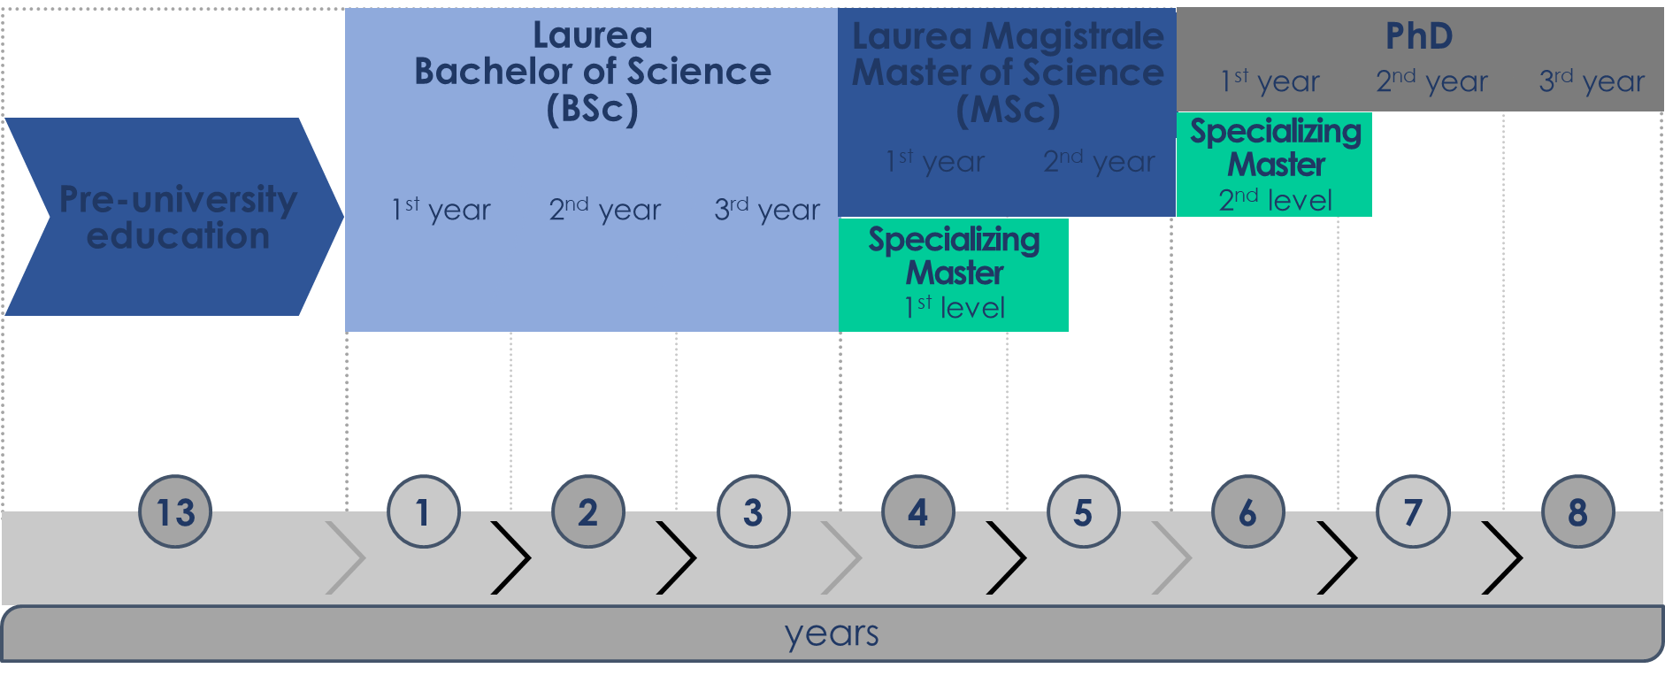
Introduction to PoliTO - Higher education system in Italy
Development of the targeted Educational program for Bachelors in Solar Energy in Uzbekistan
101128871 — DEBSEUz — ERASMUS-EDU-2023-CBHE

Slide 9
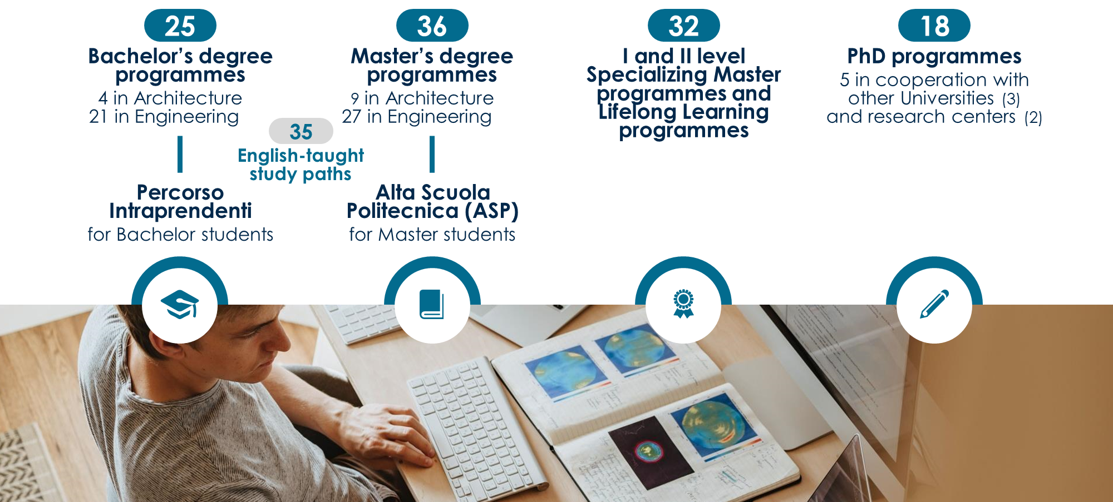
Introduction to PoliTO - Course Catalogue A.Y. 2023/2024
Development of the targeted Educational program for Bachelors in Solar Energy in Uzbekistan
101128871 — DEBSEUz — ERASMUS-EDU-2023-CBHE

Slide 10
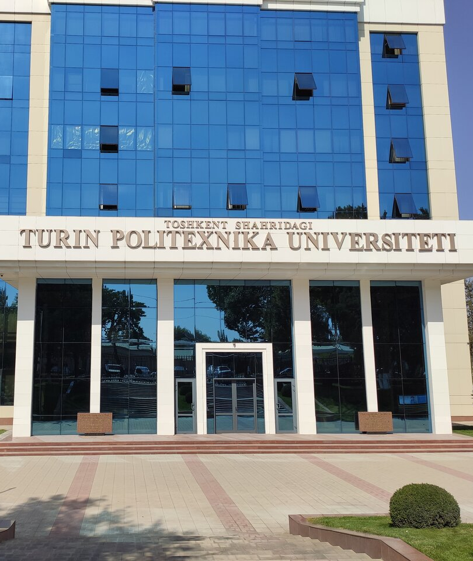
Introduction to PoliTO – Uzbekistan focus
Development of the targeted Educational program for Bachelors in Solar Energy in Uzbekistan
101128871 — DEBSEUz — ERASMUS-EDU-2023-CBHE
Project UZBEKISTAN
TEACHING
more than 1,000 students already graduated
BSc
Mechanical, Automotive, Aerospace, ICT, Civil Engineering
Professionalizing Degree
Industrial Production (new: since 2022)
PoliTO Teaching Quality
35% credits taught by PoliTo faculty on site + overall supervision
GYM | Grow Your Methodology An on-campus initiative for experimenting new teaching methods

Slide 11
Introduction to PoliTO – Uzbekistan focus
Development of the targeted Educational program for Bachelors in Solar Energy in Uzbekistan
101128871 — DEBSEUz — ERASMUS-EDU-2023-CBHE
Project UZBEKISTAN
Partnership with TTPU |
Turin Polytechnic University in Tashkent
Our TTPU campus in Tashkent
An Italian base in Central Asia for technology transfer, cultural and institutional activities, industrial collaboration
The Techno Park, a COMPANY INCUBATOR
More than 25 projects for the Country's technological development and innovation
Stimulates the involvement of Italian companies and institutions
A Lab for Surveys of the built environment and Geomatics
The Juventus Academy, since 2019

Slide 12
Introduction to PoliTO – Uzbekistan focus
Development of the targeted Educational program for Bachelors in Solar Energy in Uzbekistan
101128871 — DEBSEUz — ERASMUS-EDU-2023-CBHE
Most relevant projects and recent initiatives
Capacity building projects – European Union Funding | Lifelong Learning and vocational training | Technoloy transfer for most relevant global transition – Energy and Industry 4.0
ERAMCA → Risk Assessment and Mitigation for cultural heritage DEBSEUZ → Design and maintenance for solar energy systems SPHERE → Design and maintenance for electrical-driven vehicles | Professionalizing degree → Industrial Manufacturing Technologies. Opportunities for reskilling and upskilling of employees UzAvto Plant Academy → CIM4.0 and UzAvto on training for key production competences | UzAvto Academy 4.0 → CIM4.0, UzAvto, TTPU on key trasformation competences for Industry 4.0 Hydrogen Valley in Karshi → feasibility study based on MoU signed during the visit of President Shavkat Mirziyoyev (June 2023)

Slide 13
Role in the project and key staff
Development of the targeted Educational program for Bachelors in Solar Energy in Uzbekistan
101128871 — DEBSEUz — ERASMUS-EDU-2023-CBHE
WE ARE Department of Energy - DENERG AT POLITO!

Slide 14
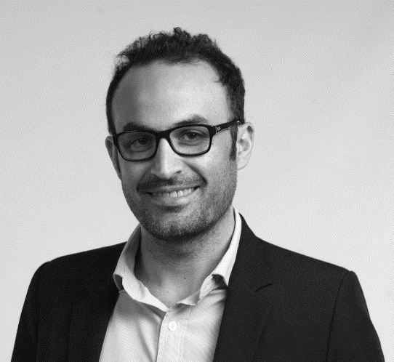
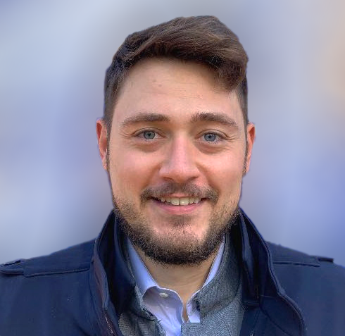
Role in the project and key staff
Development of the targeted Educational program for Bachelors in Solar Energy in Uzbekistan
101128871 — DEBSEUz — ERASMUS-EDU-2023-CBHE
@
pierluigi.leone@polito.it
marco.cavana@polito.it
Pierluigi Leone, PhD
Full Professor at PoliTO and Project Manager at TTPU
PoliTO Responsible for DEBSEUZ
Marco Cavana, PhD
Assistant Professor at PoliTO
During his PhD he worked on a model for quality tracking in gas networks in view of renewable gases blending. He participated as scientific advisor in the design and techno-economic feasibility of projects on green hydrogen production and deployment.

Slide 15
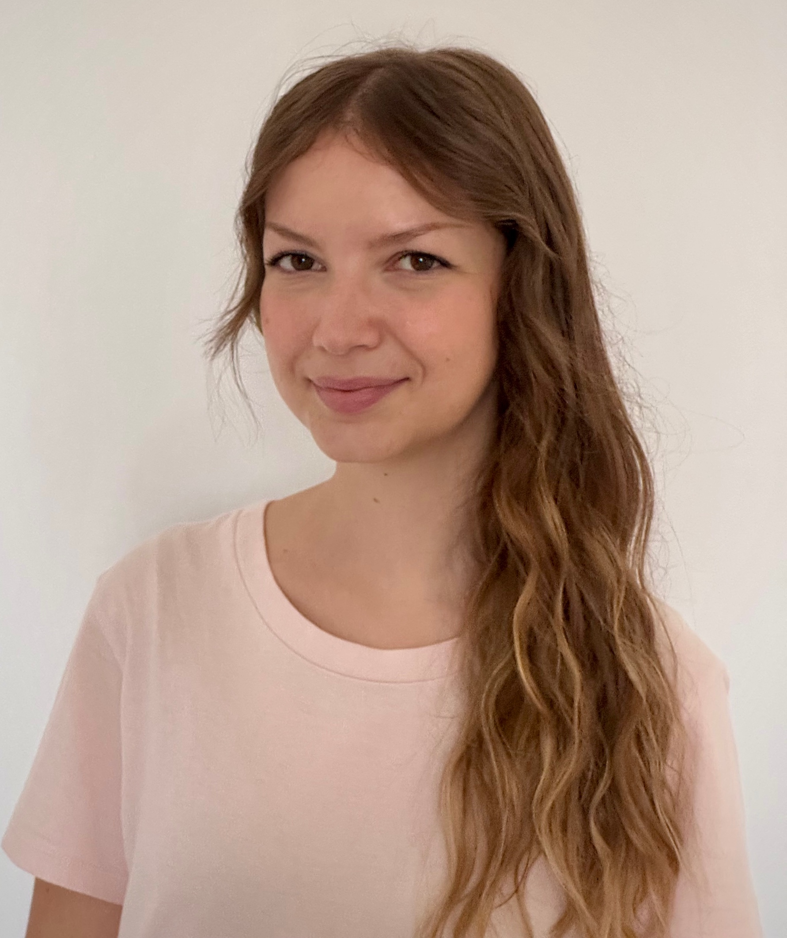
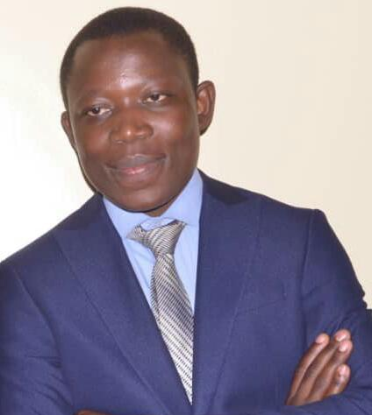
Role in the project and key staff
Development of the targeted Educational program for Bachelors in Solar Energy in Uzbekistan
101128871 — DEBSEUz — ERASMUS-EDU-2023-CBHE
@
luisa.difrancesco@polito.it
pacifique.koshikwinja@polito.it
Luisa Di Francesco
PhD Student at PoliTO
She graduated in Energy Engineering – Renewable Energy Systems at PoliTO. The focus of her master’s thesis was green hydrogen production and blending in natural gas for the German gas transmission network.
Pacifique
PhD Candidate at PoliTO
His current research focuses on the regional energy modeling for green energy carriers production and utilization in Africa, with a particular focus on the role of productive uses of energy in the clean energy access process. He also has valuable experience in international projects across different African countries related to capacity building, biomass conversion, and renewable energy microgrids.

Slide 16
Role in the project and key staff
Development of the targeted Educational program for Bachelors in Solar Energy in Uzbekistan
101128871 — DEBSEUz — ERASMUS-EDU-2023-CBHE
Administration
Angela Spiteri, Administrive contact for DEBSEUz at PoliTO
Massimiliano Rapetti, Head of Project Administration at DENERG DENERG PROGETTI, Recipient for adiministration issues – NOT a PERSON!!!
@
angela.spiteri@polito.it
massimiliano.rapetti@polito.it
denerg.progetti@polito.it

Slide 17
Role in the project and key staff
Development of the targeted Educational program for Bachelors in Solar Energy in Uzbekistan
101128871 — DEBSEUz — ERASMUS-EDU-2023-CBHE
WP4 Leader – Equipment for the establishment of laboratories and centers
CO –leader in WP1 (Management) and WP5 (quality)

Slide 18
Experience in previous capacity building project
Development of the targeted Educational program for Bachelors in Solar Energy in Uzbekistan
101128871 — DEBSEUz — ERASMUS-EDU-2023-CBHE
EU Coordinator – Erasmus + CBHE Enbrain – call2017
EU Coordinator – Erasmus + CBHE Neprev – call2019
Unit Coordinator – Erasmus + CBHE Heresa – call2020
Italian Agency for Development Cooperation – G7 African Innovation Leaders
RES4AFRICA X UNECA – Expert training in energy system modelling and scenario for Horn Africa

Slide 19
Thank you for attention!
Development of the targeted Educational program for Bachelors in Solar Energy in Uzbekistan
101128871 — DEBSEUz — ERASMUS-EDU-2023-CBHE

