Slide 1









Development of the targeted Educational program for Bachelors in Solar Energy in Uzbekistan
101128871 — DEBSEUz — ERASMUS-EDU-2023-CBHE
JIZZAKH POLYTECHNIC INSTITUTE
22.01.2024
Tashkent

Slide 2


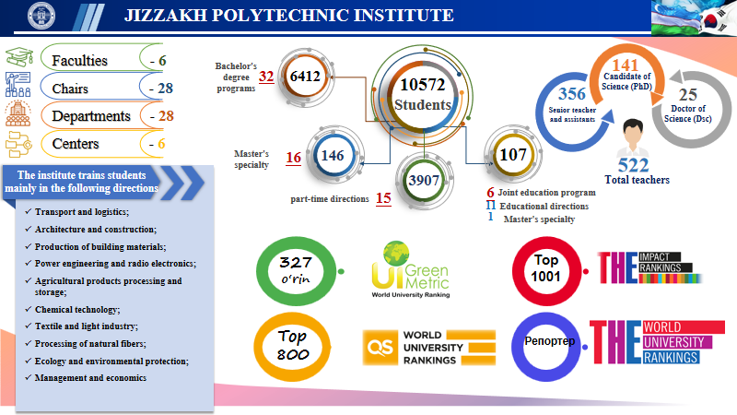


Development of the targeted Educational program for Bachelors in Solar Energy in Uzbekistan
101128871 — DEBSEUz — ERASMUS-EDU-2023-CBHE

Slide 3
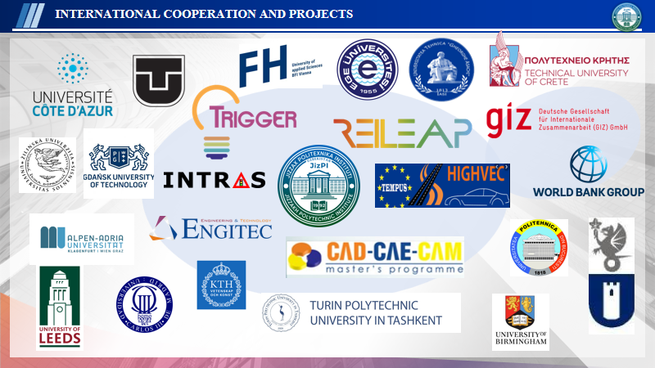
Development of the targeted Educational program for Bachelors in Solar Energy in Uzbekistan
101128871 — DEBSEUz — ERASMUS-EDU-2023-CBHE

Slide 4

Development of the targeted Educational program for Bachelors in Solar Energy in Uzbekistan
101128871 — DEBSEUz — ERASMUS-EDU-2023-CBHE

Slide 5

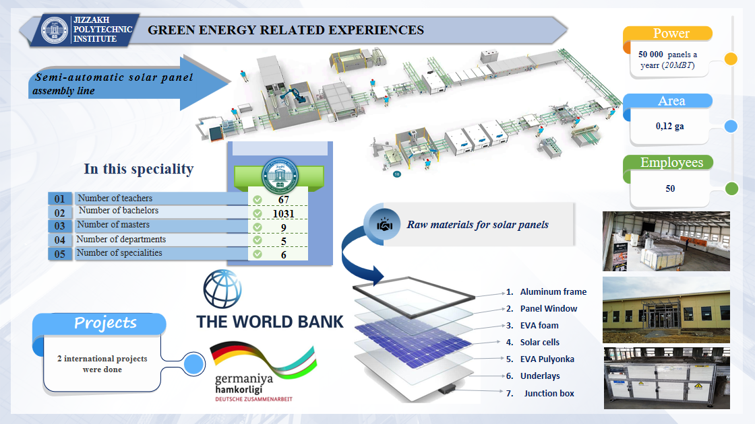
Development of the targeted Educational program for Bachelors in Solar Energy in Uzbekistan
101128871 — DEBSEUz — ERASMUS-EDU-2023-CBHE

Slide 6
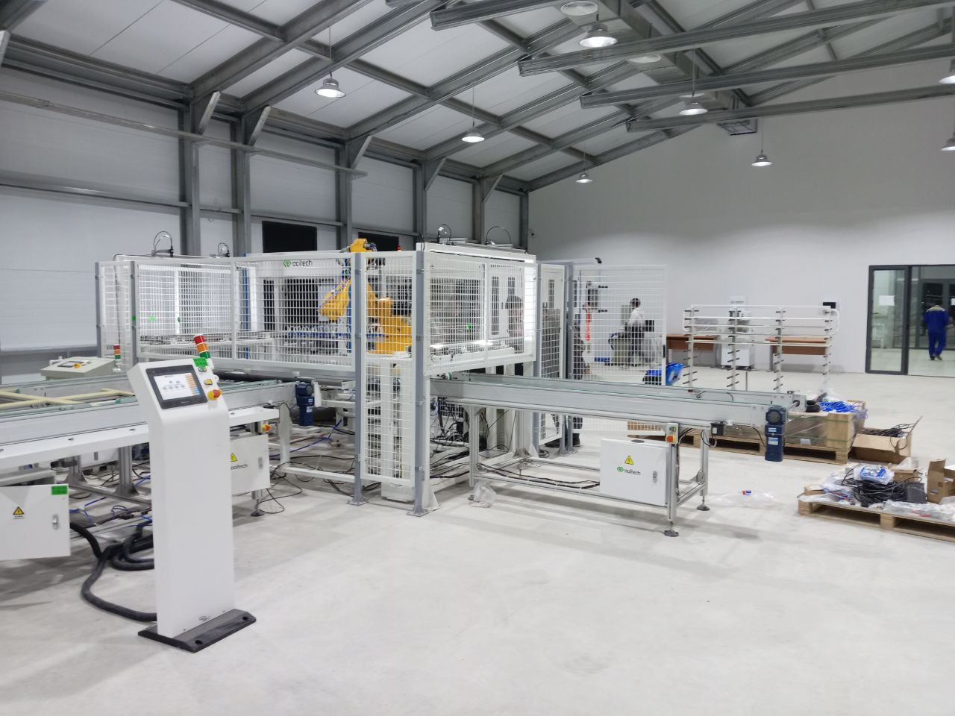
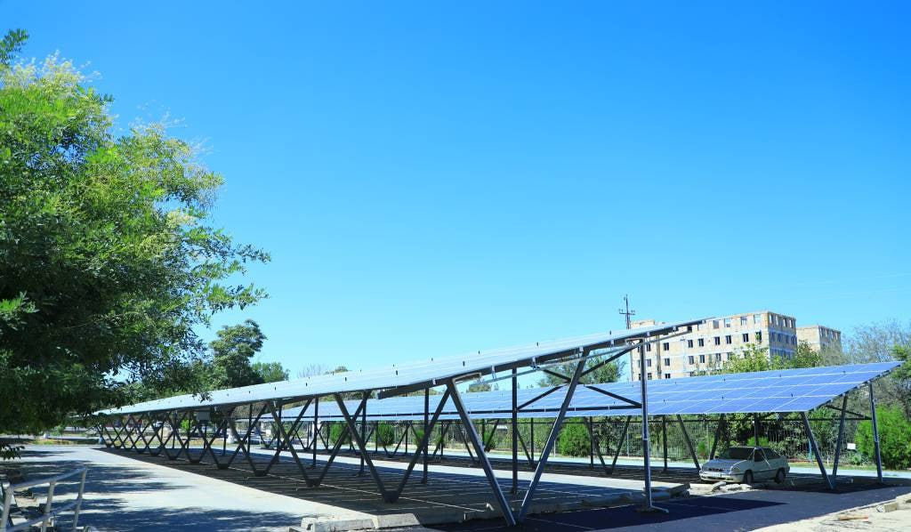
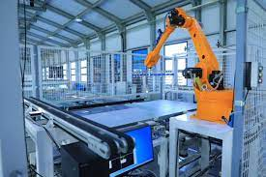
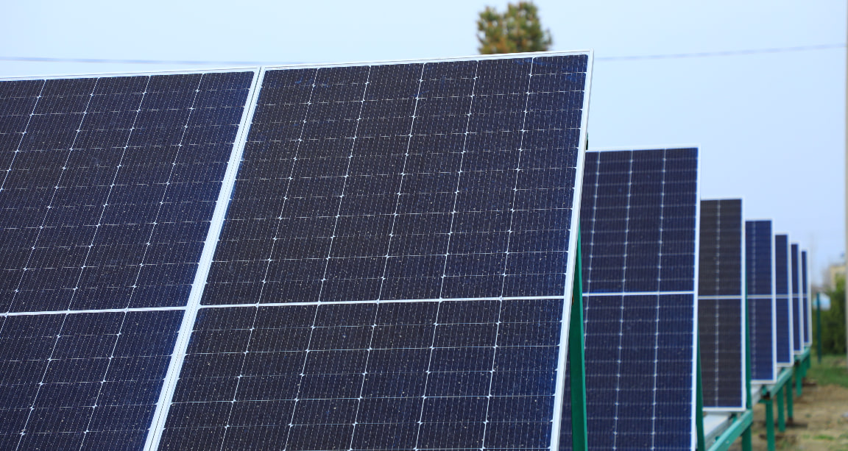
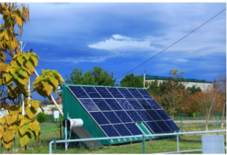
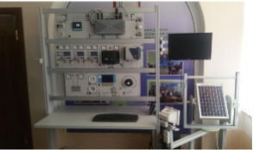
Development of the targeted Educational program for Bachelors in Solar Energy in Uzbekistan
101128871 — DEBSEUz — ERASMUS-EDU-2023-CBHE

Slide 7
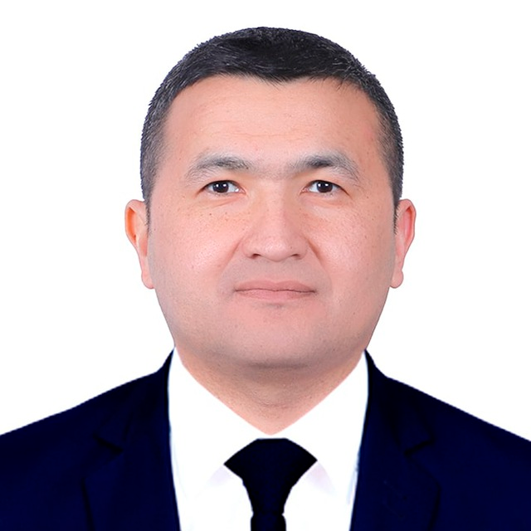
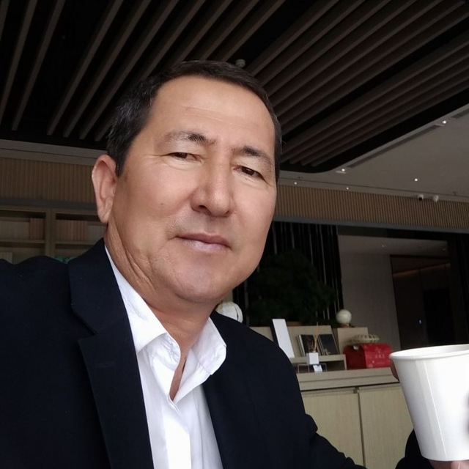
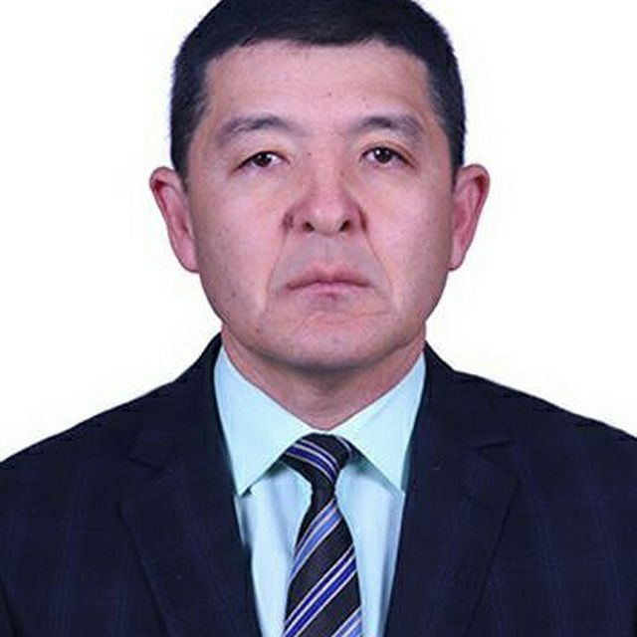
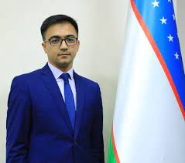
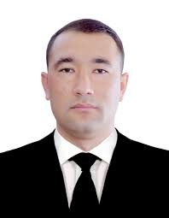
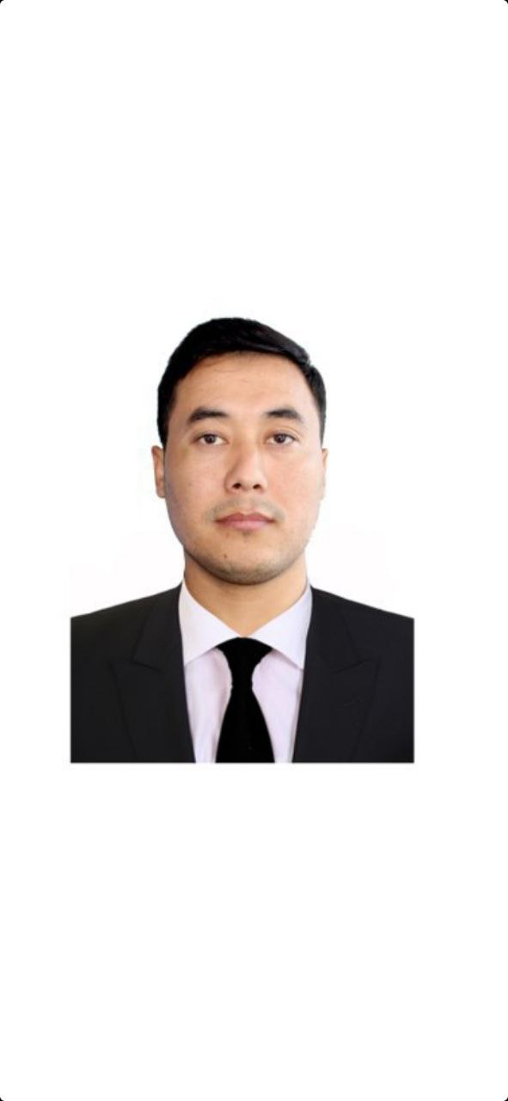
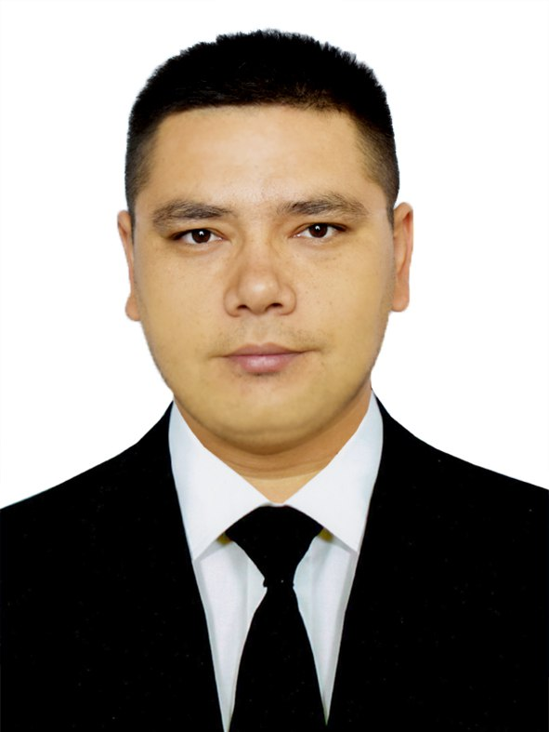
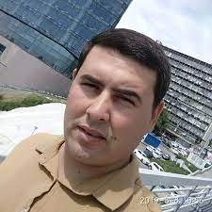
OUR TEAM(TO BE UPDATED)
Development of the targeted Educational program for Bachelors in Solar Energy in Uzbekistan
101128871 — DEBSEUz — ERASMUS-EDU-2023-CBHE
Temur Berdiyorov
Local coordinator
Muxiddin Anorboev
Team member
Bahodir Narimonov
Team member
Jamshid Abdunazarov
Team member
Elnur Abdullaev
Team member
Uchqun Mirzaev
Team member
Otabek Arzikulov
Team member
Xasan Abdiev
Team member

Slide 8
Thank you for attention!
Development of the targeted Educational program for Bachelors in Solar Energy in Uzbekistan
101128871 — DEBSEUz — ERASMUS-EDU-2023-CBHE

