Slide 1
(DEBSEUz): Development of the targeted Educational program for Bachelors in Solar Energy in Uzbekistan
Fergana Polytechnic Institute

Slide 2
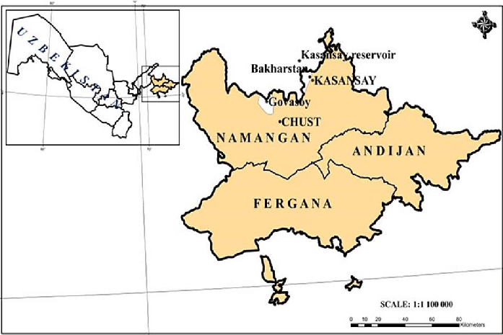
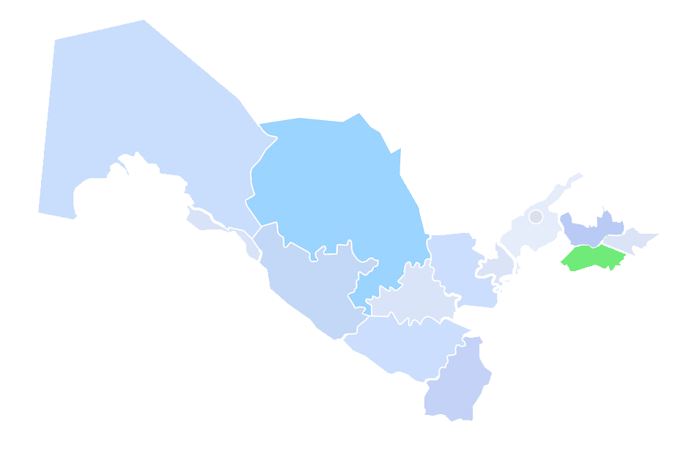
Location
Tashkent
Fergana
polytechnic
institute

Slide 3
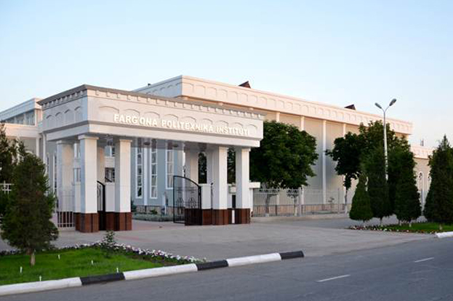
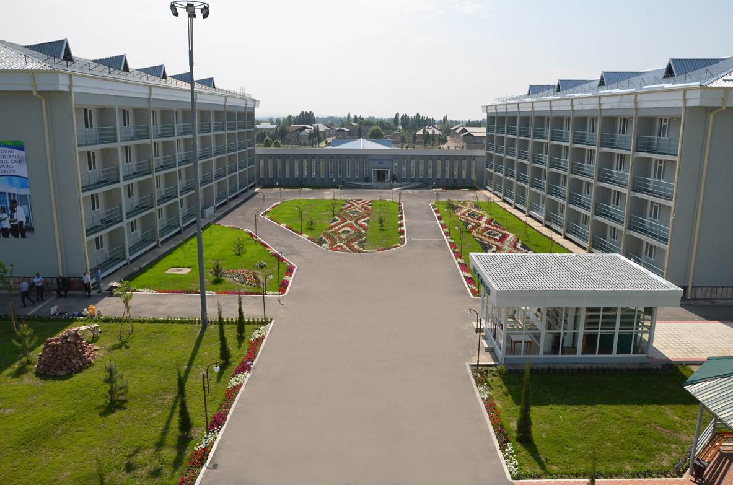
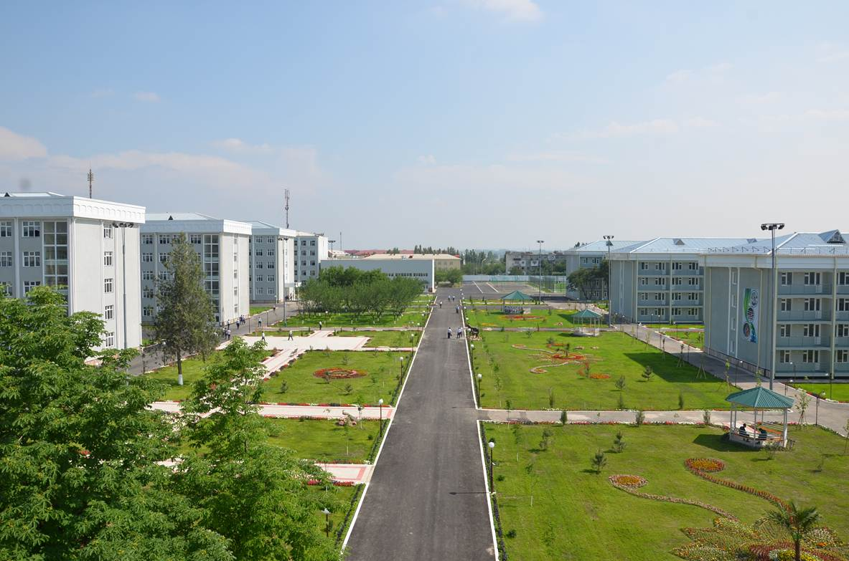
Contact details of Partner
(DEBSEUz): Development of the targeted Educational program for Bachelors in Solar Energy in Uzbekistan
The best picture from the partner university life
Web –site: http://ferpi.uz/
Social media channels:
Telegram: @farpipress
Facebook: @farpilive
Instagram: @farpi_press
You tube: @farpilive
3. Address: Fergana city, 86, Fergana street
4. DEBSEUz project web-page link: DEBSEUz (ferpi.uz)
5. Tel number: +998 (73) 241 12 06
e-mail: ferpi_info@edu.uz

Slide 4
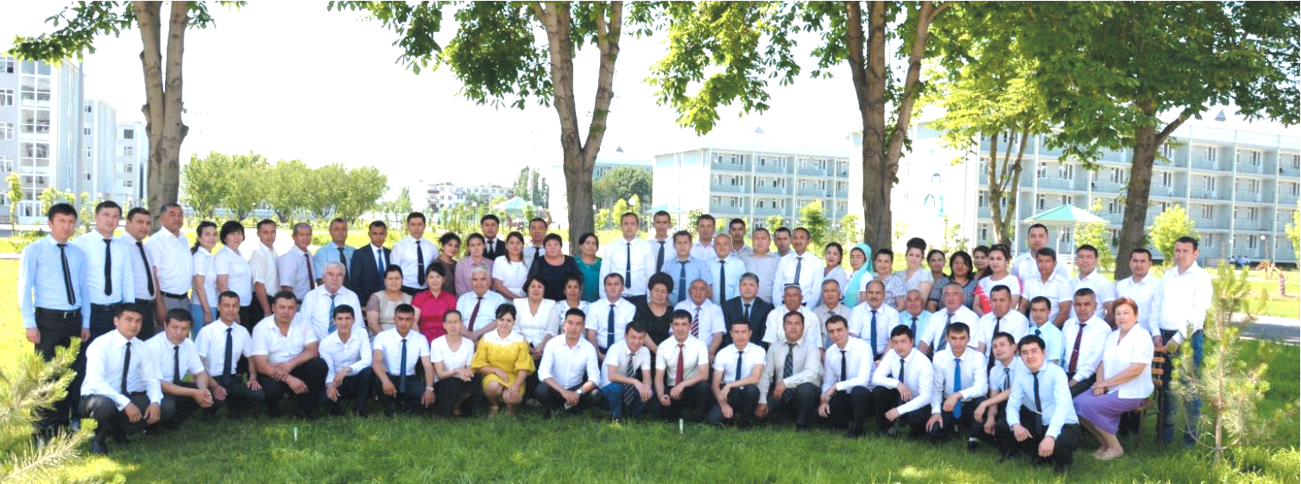
About of ‘‘ Fergana Polytechnic Institute’’
7
31
17
38
152
faculties
departments
Master degree programs
14768
Bachelor degree programs
Total students(on the basis of full and part time)
9627
530
PhD fellows
473
Bachelor students
professor-teachers staff
Master students

Slide 5
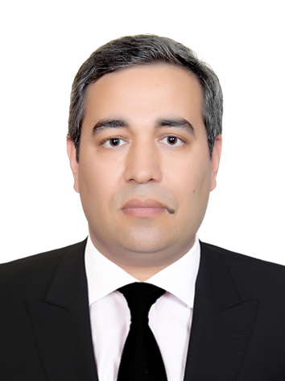
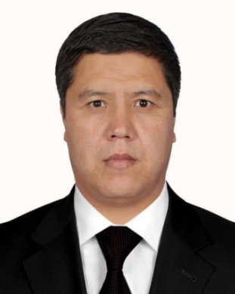
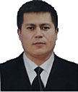
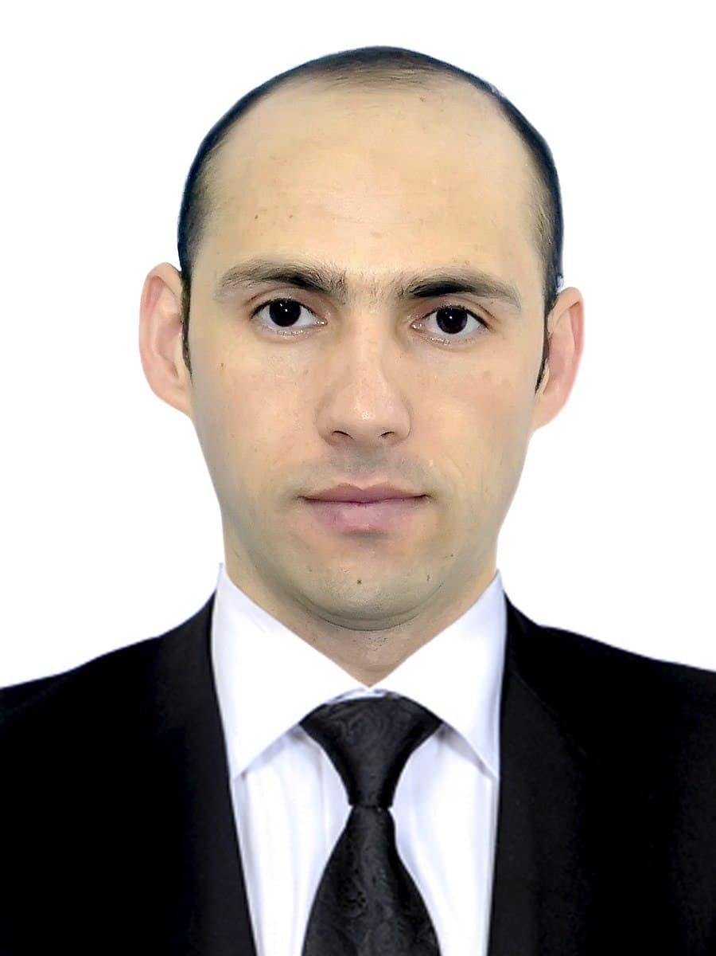
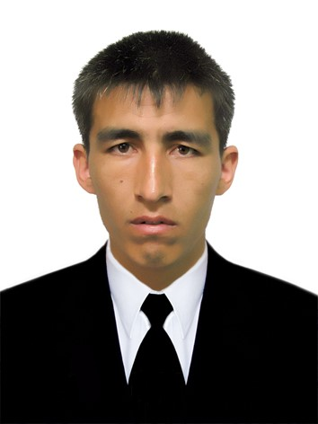
Team members of partner university
(DEBSEUz): Development of the targeted Educational program for Bachelors in Solar Energy in Uzbekistan
Coordinator
(Management)
Salomov Uktam Rakhimovich
Rector of Fergana polytechnic institute
E-mail: ferpi_info@edu.uz
Tel number: +998 90 324 82 56
Teacher (Development/
Establishment)
Kuchkarov Akmaljon Akhmadaliyevich
Head of the Electronics and Instrumentation department, PhD
Faculty of Computer-Aided Designing Systems
E-mail: a.kuchkarov@ferpi.uz
Tel number: +998 91 662 41 02
Teacher (Development/
Establishment)
Uzbekov Mirsoli Odiljanovich
Dean of the Faculty of Electrical Engineering. PhD
E-mail: m.uzbekov@ferpi.uz
Tel number: +998 90 775 65 15
Administration staff
(Financial)
Ismailov Nodirbek Mamasidikovich
Head of department of international cooperation
Department of international cooperation
E-mail: n.ismailov@ferpi.uz
Tel number: +998 99 368 68 49
Technician
(Dissemination)
Mamatov Olmosbek Muhammaddovidovich
Deputy dean for scientific affairs
Senior Lecturer at the Department of Electronics and Instrumentation, PhD
Email: o.mamatov@ferpi.uz
Tel number: +998 90 530 63 68

Slide 6
Preparation
(DEBSEUz): Development of the targeted Educational program for Bachelors in Solar Energy in Uzbekistan
Analyzed and compared teaching systems and studying experience of Solar Energy of EU countries
Analyzed employment market of the region and the need of organizations for this program specialists
Discussed the chosen template teaching systems of the EU countries with partner universities Karakalpak State University (KSU), Jizzakh polytechnic institute (JizPi)

Slide 7
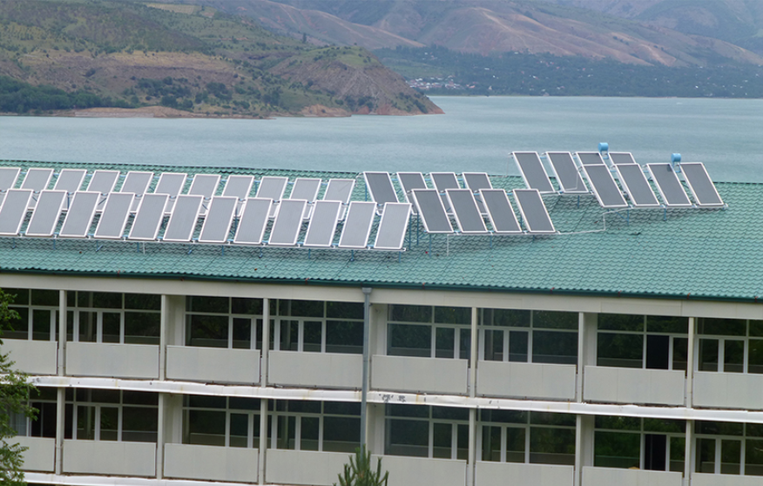
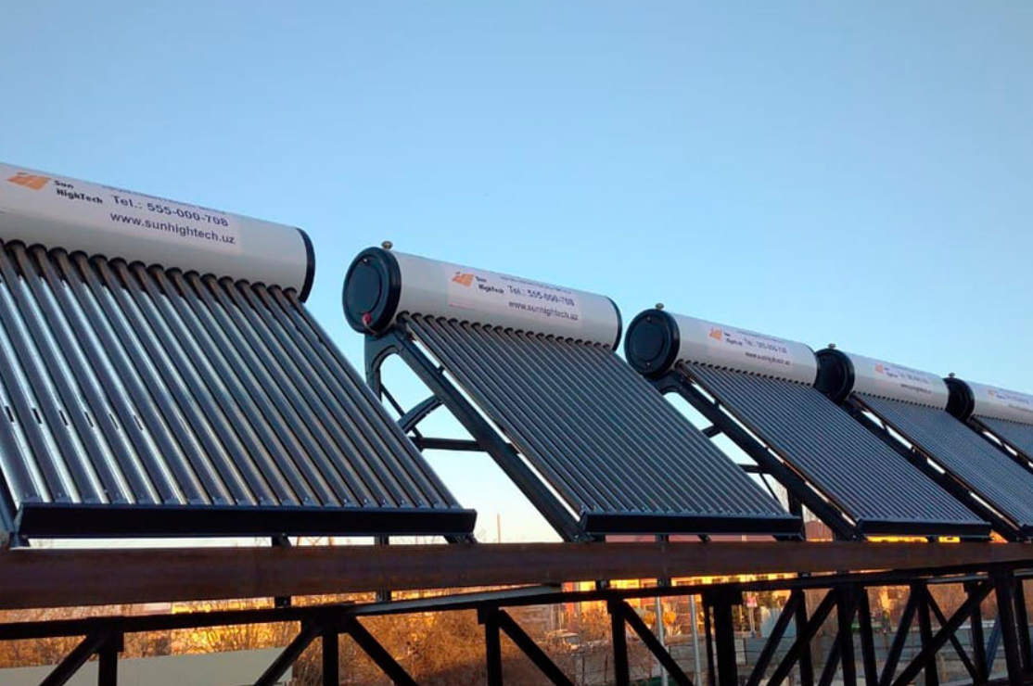
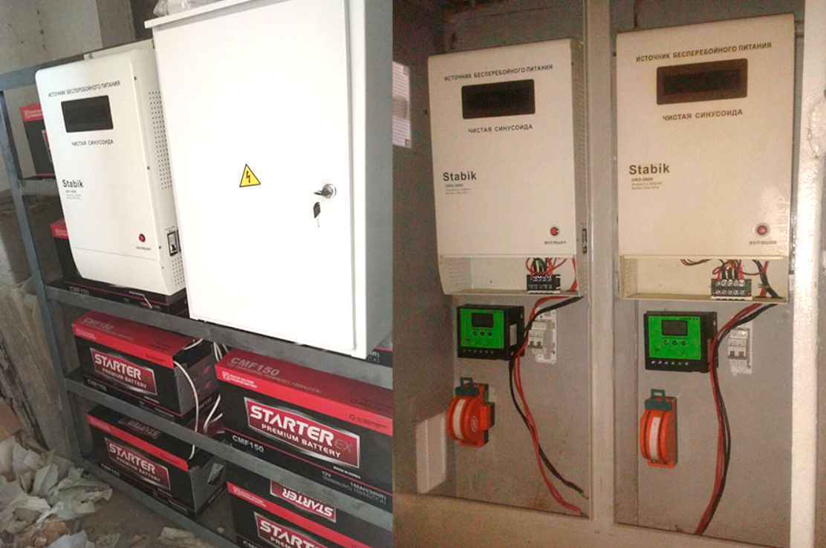
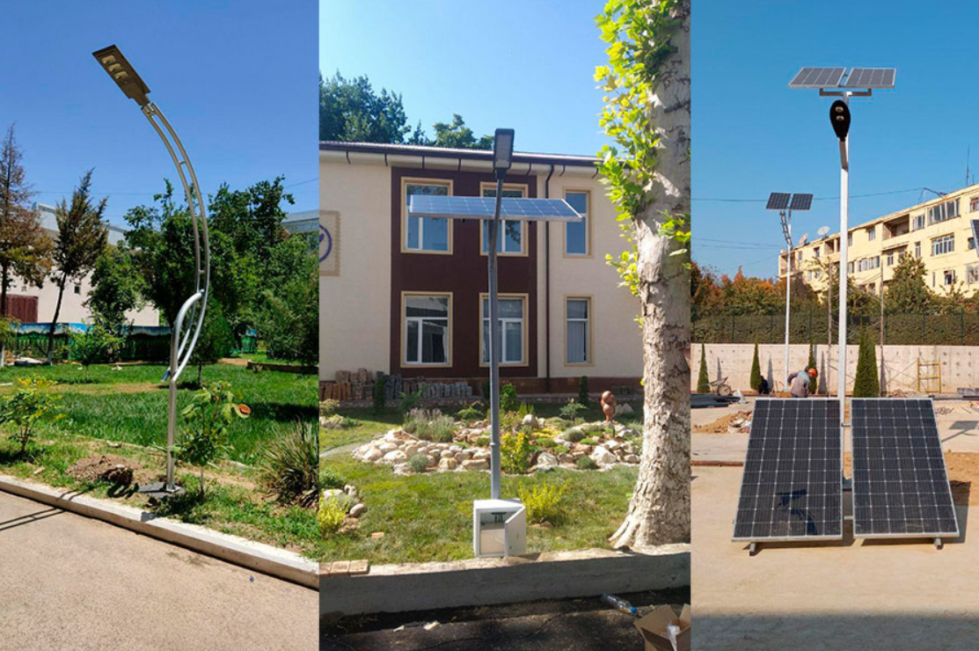
Preparation
(DEBSEUz): Development of the targeted Educational program for Bachelors in Solar Energy in Uzbekistan
List of organizations interested
№ | Company name | Location
1 | “MIR-SOLAR” LLC | Tashkent
2 | “SUN-HIGHTECH” LLC | Tashkent
3 | “NOVATECHNOLOGY” LLC | Ferghana
4 | “ELECTRONICS AND AUTOMATICS” UE | Ferghana
5 | “Ferghana Regional Electric Networks” JSC | Ferghana
6 | “Ferghana Inova Technologies” LLC | Ferghana
7 | “Ferghana Heating Center” JSC | Ferghana
8 | “Ferghana Main Electric Networks” JSC | Ferghana
9 | “Quartz” JSC | Ferghana
10 | “OLTIARIQ-INNOVATSIYA” LLC | Ferghana

Slide 8
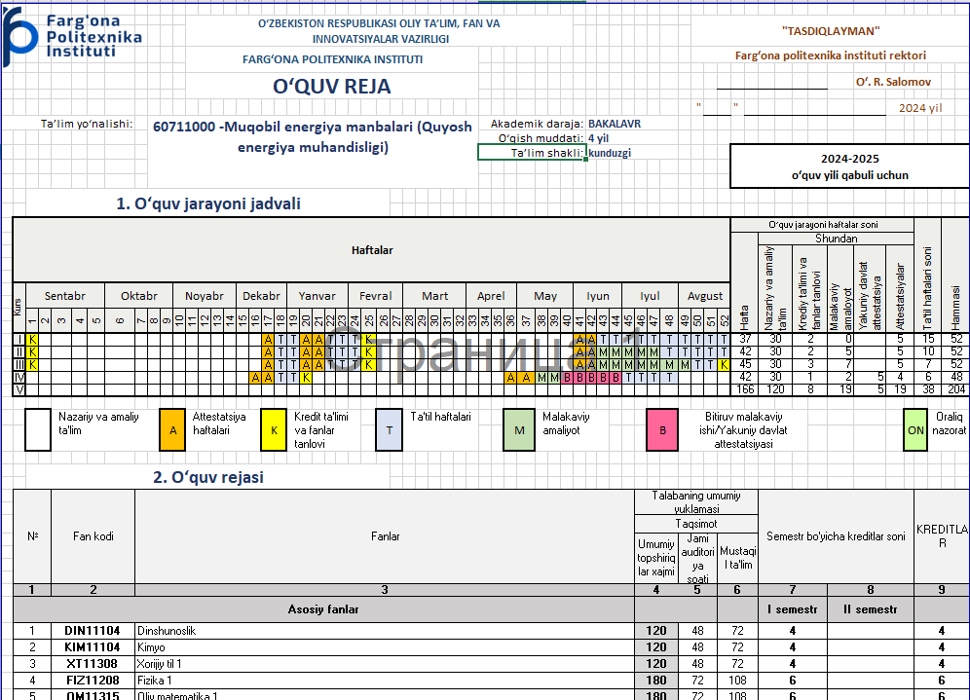
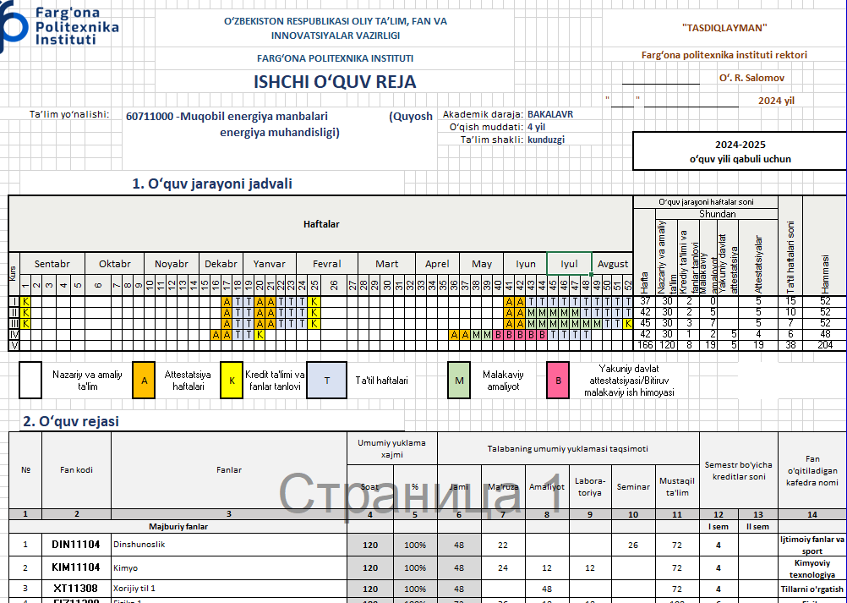
Development
(DEBSEUz): Development of the targeted Educational program for Bachelors in Solar Energy in Uzbekistan
In the 2024-2025 academic year, a new undergraduate education course 60711000 - "Alternative energy sources (Solar energy engineering)" is planned to be opened at the Faculty of Computerized Design Systems, and working curricula for this course have been prepared.

Slide 9
Establishment
(DEBSEUz): Development of the targeted Educational program for Bachelors in Solar Energy in Uzbekistan
Establishing 60711000 -“Alternative Energy Sources (Solar Energy Engineering)” bachelor program and admitting 25 students for the first year
Established I-Lab for Solar Energy Engineering program students
Planning to open experimental engineering manufacturing centre

Slide 10
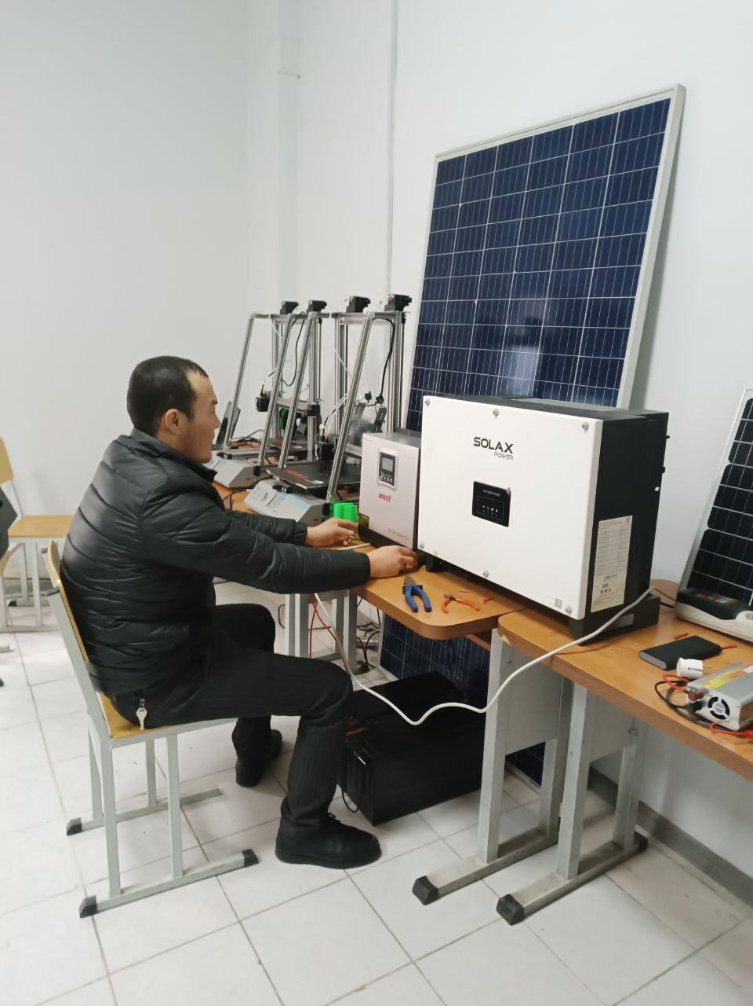
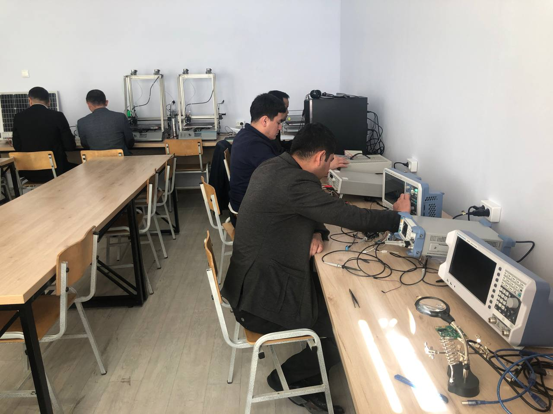
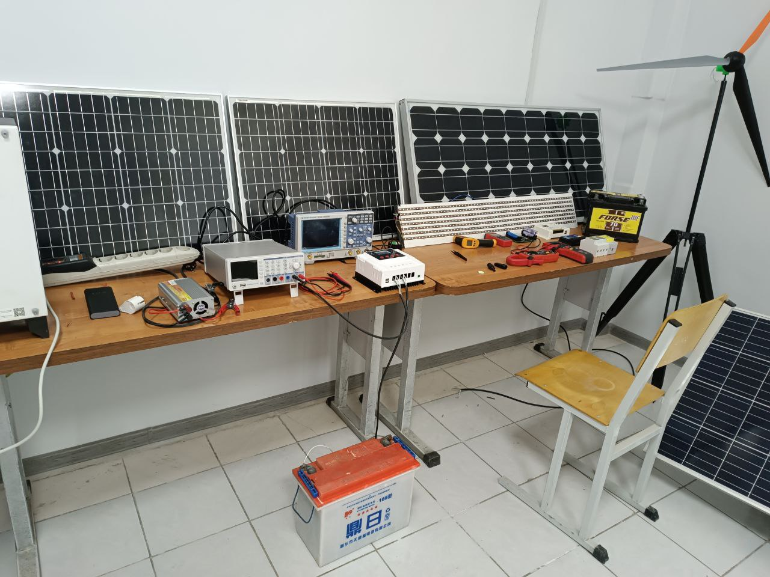
Available laboratories
(DEBSEUz): Development of the targeted Educational program for Bachelors in Solar Energy in Uzbekistan
Presentation about the laboratories
The laboratories were organized on the basis of the department «Electronics and Instrumentation», where both educational and scientific activities of relevant directions are conducted.

Slide 11
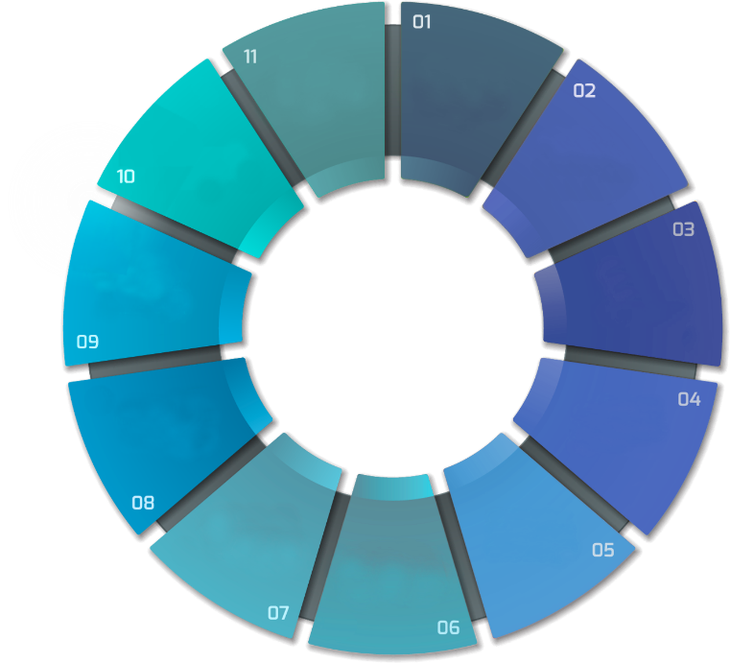
Spin OFF Companies
(DEBSEUz): Development of the targeted Educational program for Bachelors in Solar Energy in Uzbekistan
А
Р
Л
З
А
К
Р
BUSINESS
VECTOR
FARPI MECH
TECHNO
14 spin-off enterprises were established using foreign experience in order to implement the effective activity of the centers, and 27.0 billion. 40 scientific and innovative projects, as well as 547 economic contracts were executed.
А
POWER PROJECT
М
СПИН ОФФ
КОМПАНИЯЛАР
14 ТА
FARPI
TEXTILE
GROUP
FERPI
CHEMICAL
SERVIS
FARPI ALPHA
HITECH
ENGENEER

Slide 13
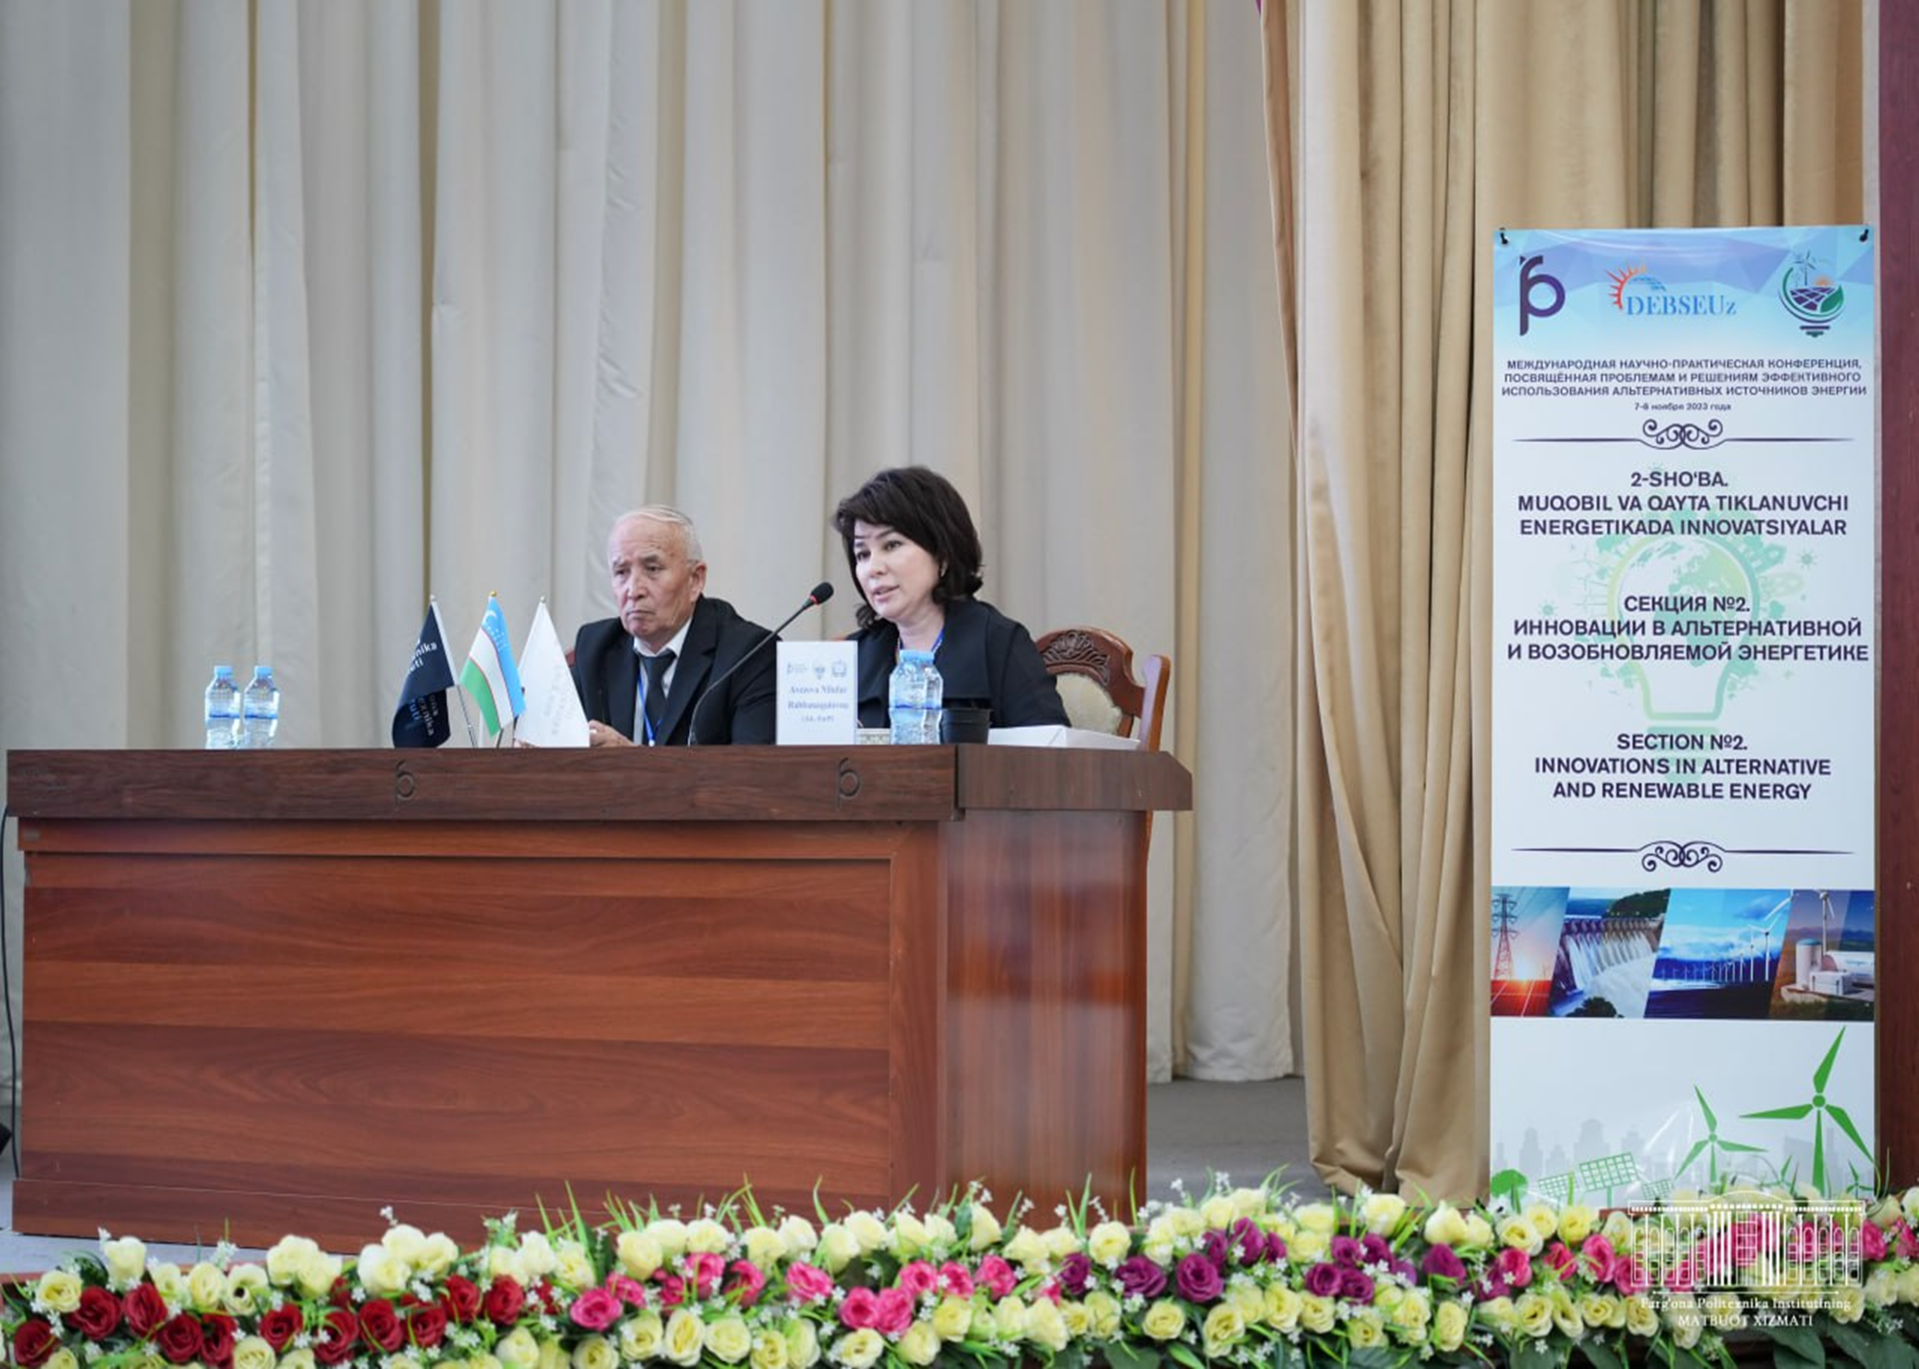
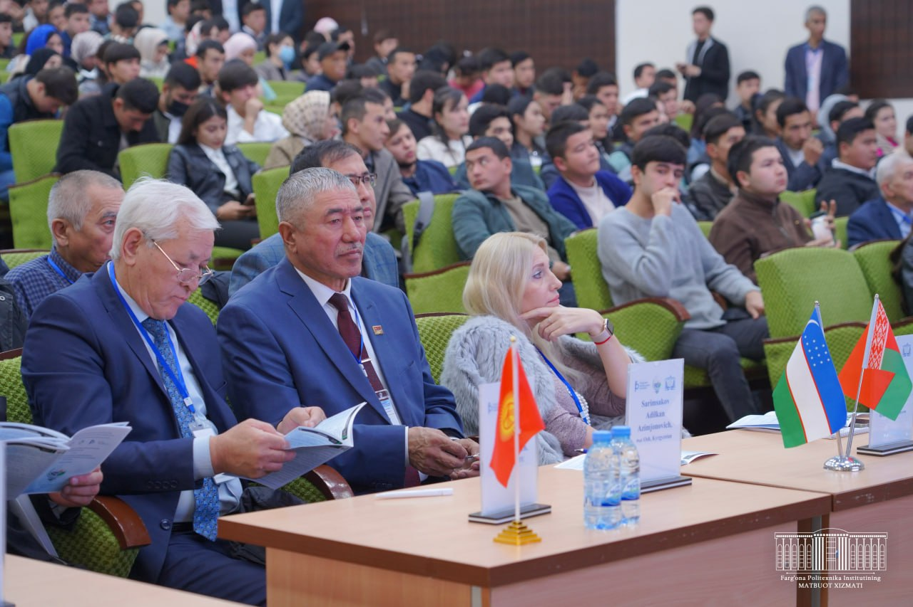
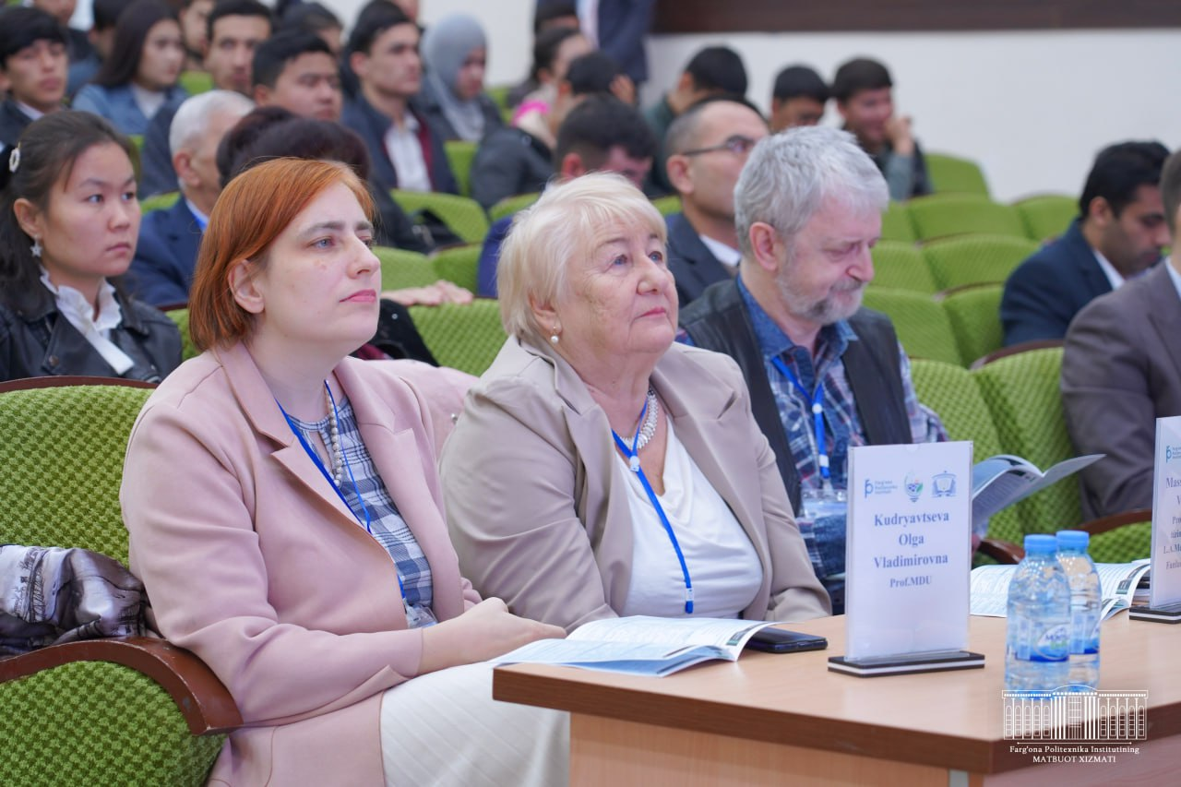
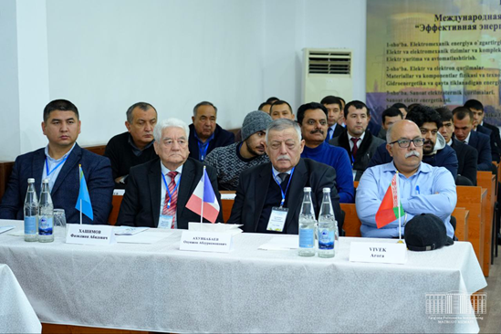
Development
(DEBSEUz): Development of the targeted Educational program for Bachelors in Solar Energy in Uzbekistan
International participants:
Italy
Belarus
Kyrgyzstan
Kazakhstan
On November 7-8, 2023, an international scientific-practical conference dedicated to "Problems and solutions of effective use of alternative energy sources" was held at the Fergana Polytechnic Institute at the initiative of the Faculty of Computerized Design Systems.
On December 14-15, 2023, an international scientific-practical conference dedicated to “Efficient energy of the future: problems and solutions" was held at the Fergana Polytechnic Institute at the initiative of the Faculty of Electrical Engineering.

Slide 14
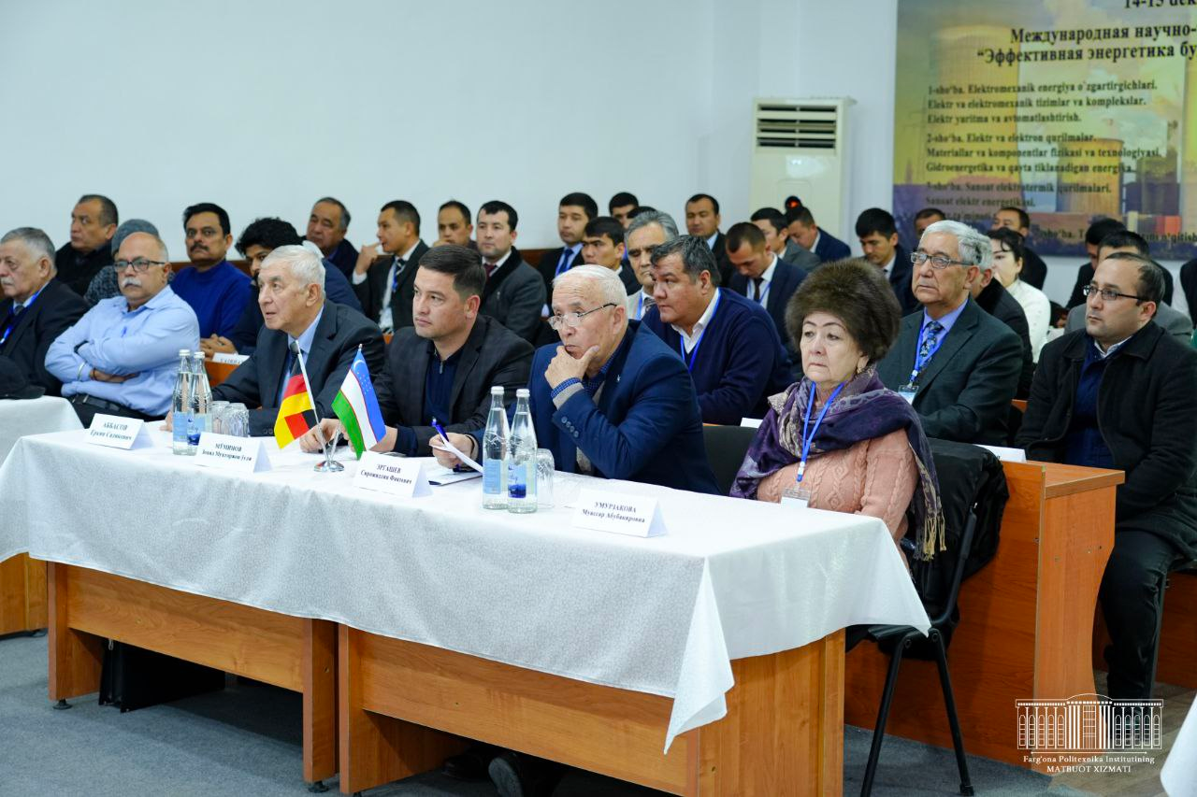
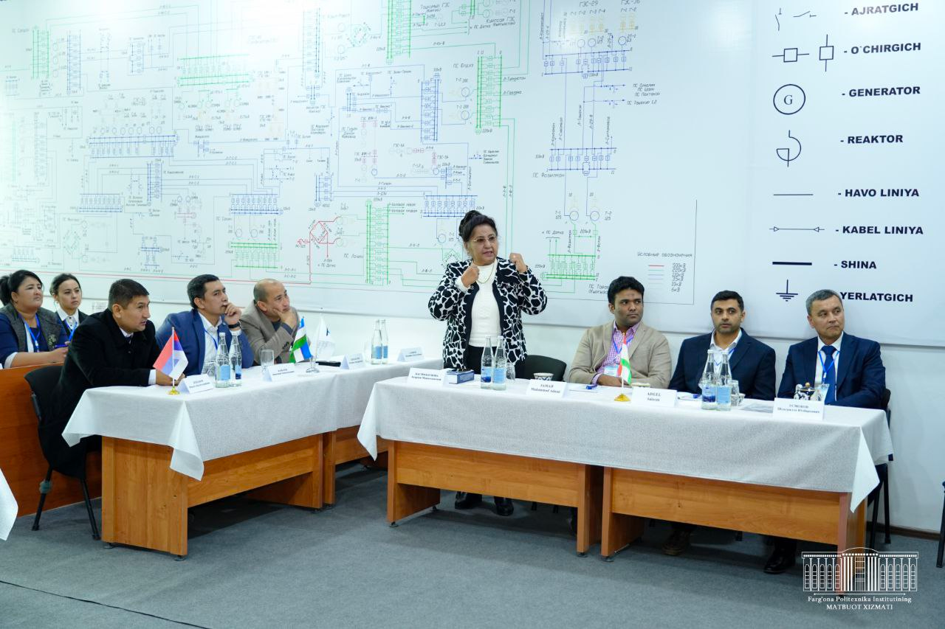
Development
(DEBSEUz): Development of the targeted Educational program for Bachelors in Solar Energy in Uzbekistan
International participants:
Pakistan
Kazakhstan
On December 14-15, 2023, an international scientific-practical conference dedicated to “Efficient energy of the future: problems and solutions" was held at the Fergana Polytechnic Institute at the initiative of the Faculty of Electrical Engineering.
In 1 section of the conferences personnel training within the framework of the DEBSEUz project was considered

Slide 15
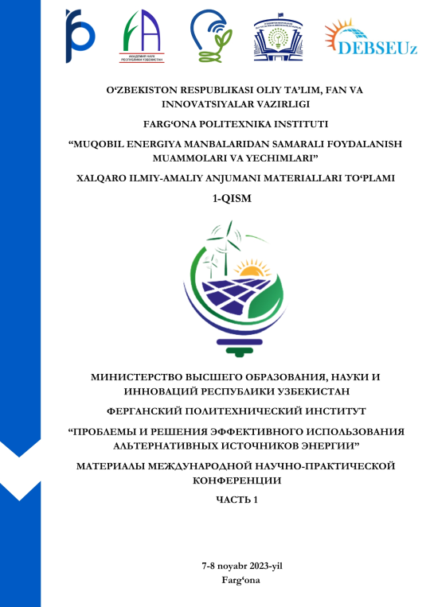
Study books are prepared for publication
(DEBSEUz): Development of the targeted Educational program for Bachelors in Solar Energy in Uzbekistan
Project performers participated with the 13 theses and two study books have been prepared

Slide 16
Dissemination A. Social: press releases, publications, workshops, conference (and commercial exhibits, scientific conferences, etc.)
(DEBSEUz): Development of the targeted Educational program for Bachelors in Solar Energy in Uzbekistan
No | Date | Activity type | Place | Partner | Evidence (URL, etc…)
1 | 05.08.2023 | Telegram post | Tashkent | TUIT | https://t.me/tuituz_official/15226
2 | 05.08.2023 | Web-site post | Tashkent | TUIT | https://tuit.uz/post/eacea-loyiha-ofitseri-maria-sol-dominguez-parrado-ozbekiston
3 | 05.09.2023 | Web-site post | Tashkent | TTPU | https://polito.uz/international-projects/
4 | 04.08.2023 | Web-site post | Jizzakh | JizPI | https://jizpi.uz/news/jizpi-oqituvchilari-yevropa-ittifoqining-erasmus-dasturi-boyicha-2-ta-grant-yutdi/
5 | 04.08.2023 | Telegram post | Jizzakh | JizPI | https://t.me/jizpi_online/23990
6 | 01.11.2023 | Web-site post | Andijan | ASU | https://adu.uz/uz/news/article/2624
7 | 01.11.2023 | Telegram post | Andijan | ASU | https://t.me/adu_uz/28779
8 | 19.10.2023 | Web-site post | Ferghana | FerPI | https://ferpi.uz/view-page/202
9 | 24.10.2023 | Telegram post | Ferghana | FerPI | https://t.me/farpipress/7528
10 | 24.10.2023 | Telegram post | Ferghana | FerPI | https://t.me/debseuz
11 | 05.12.2023 | Facebook post | Ferghana | FerPI | http://bit.ly/48Dx5ZP

Slide 17
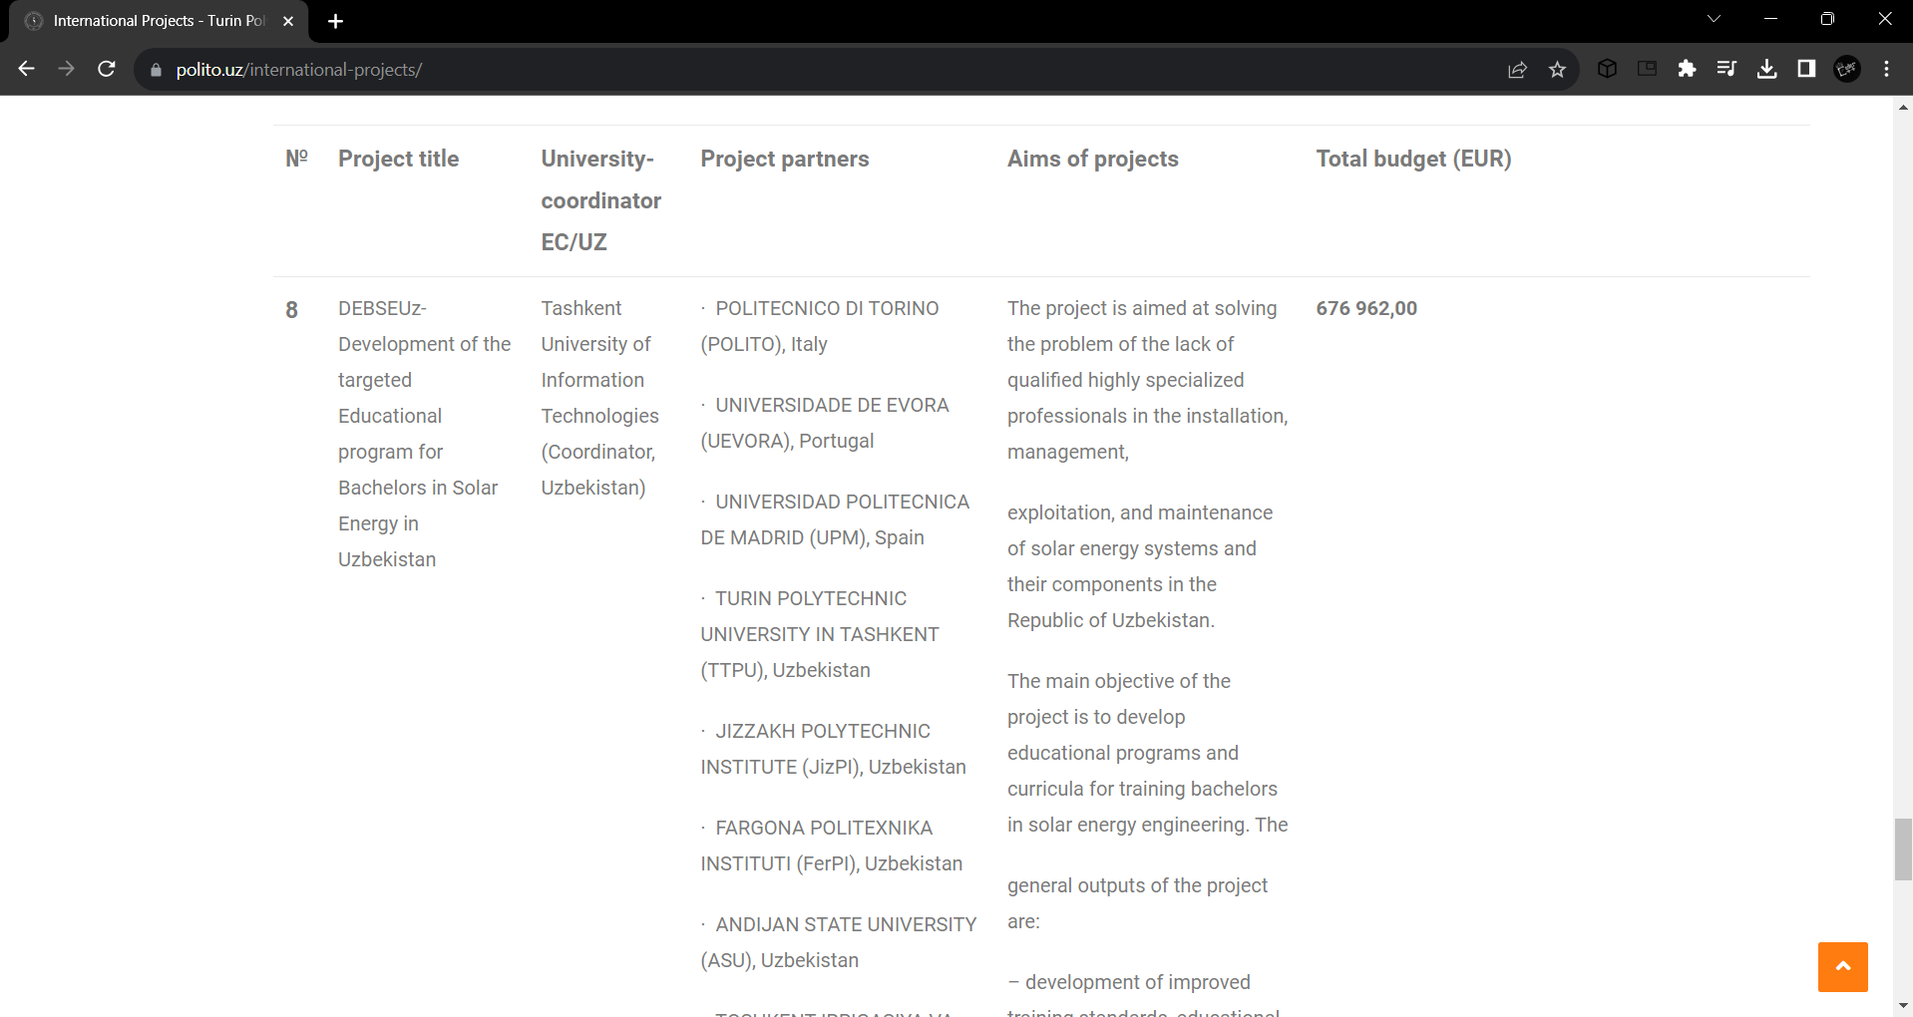
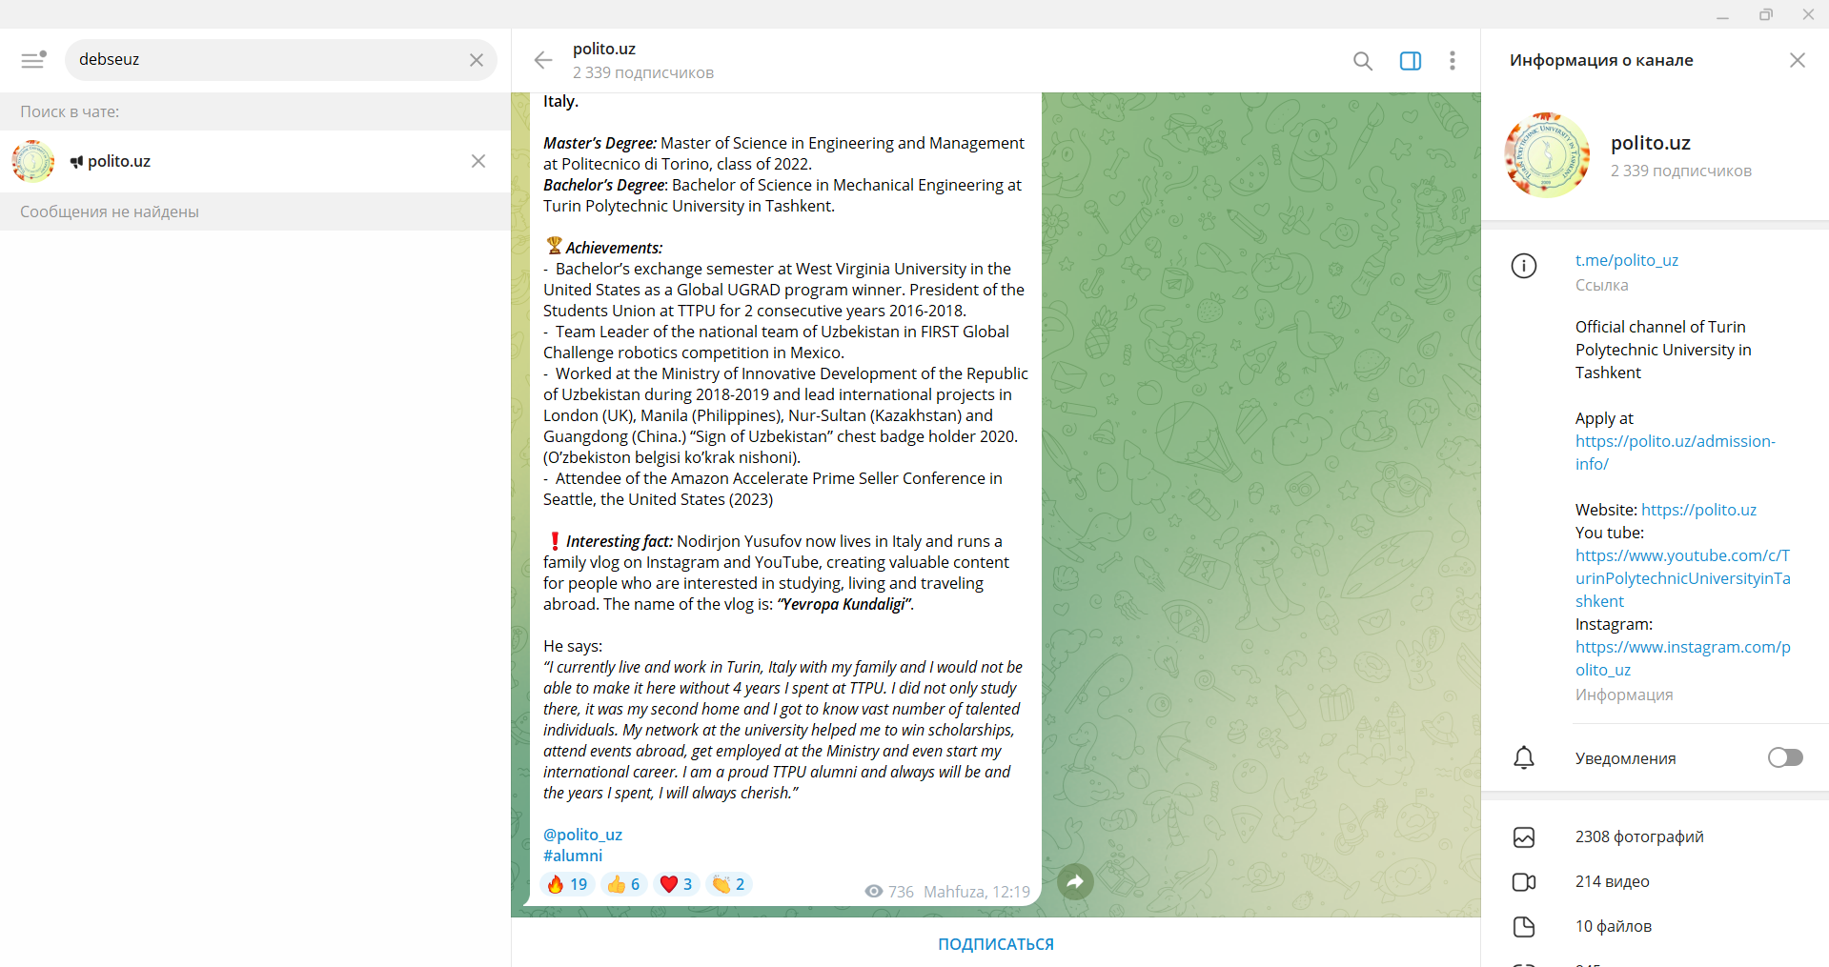
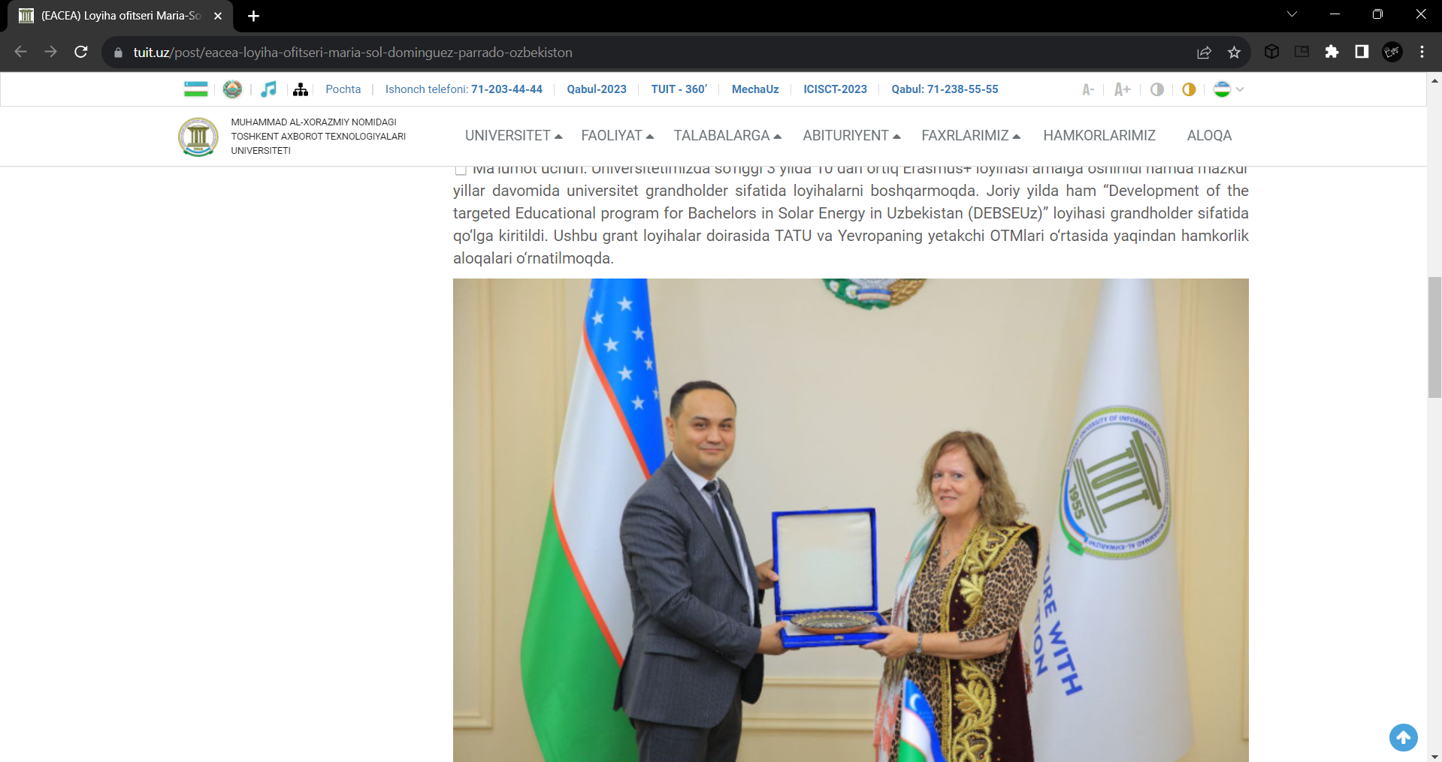
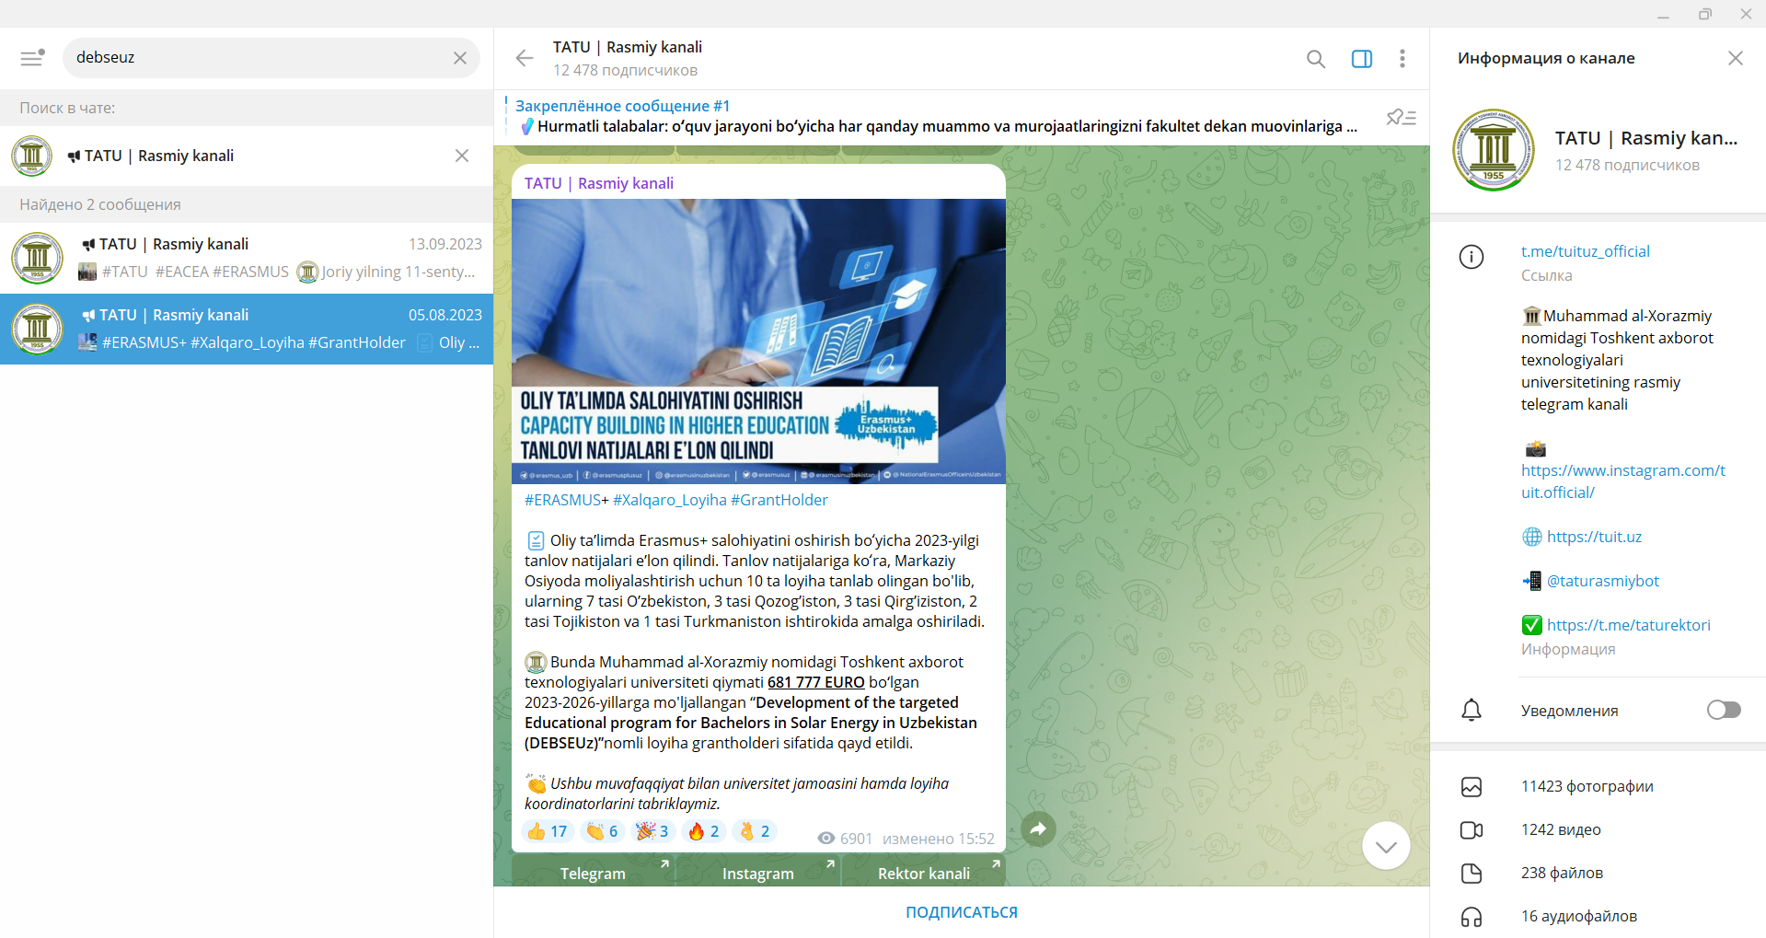
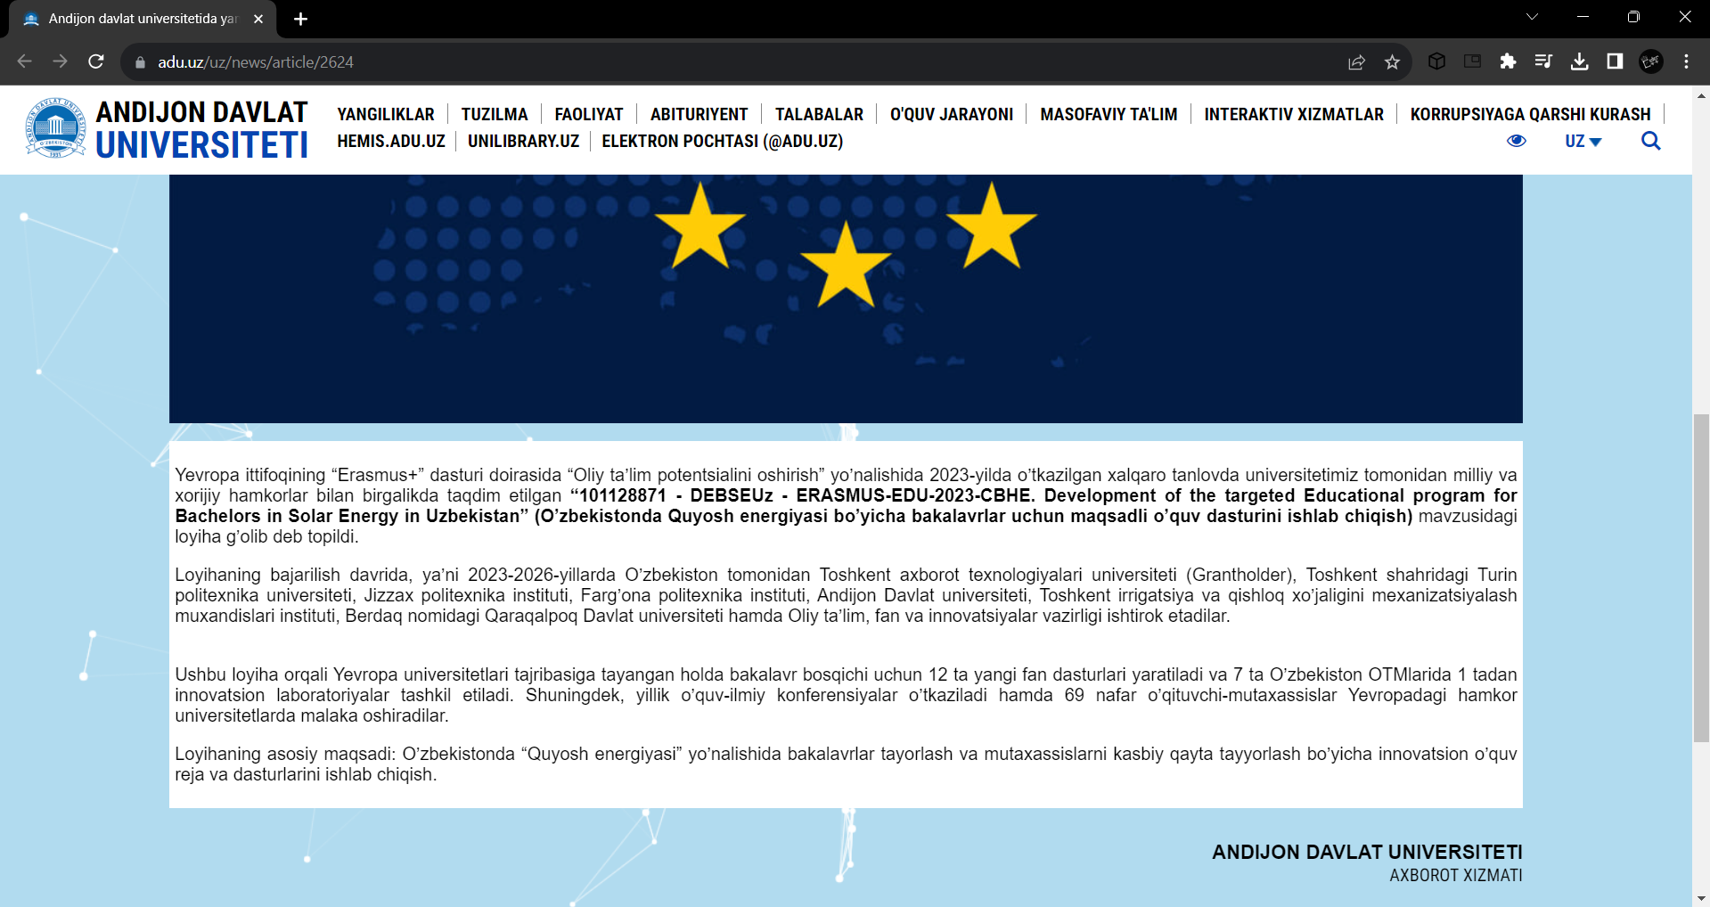
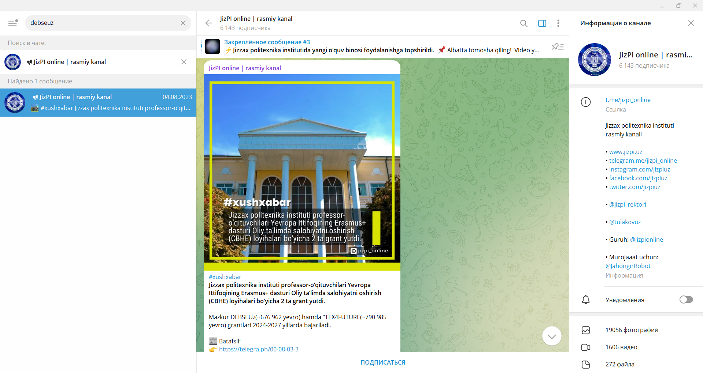
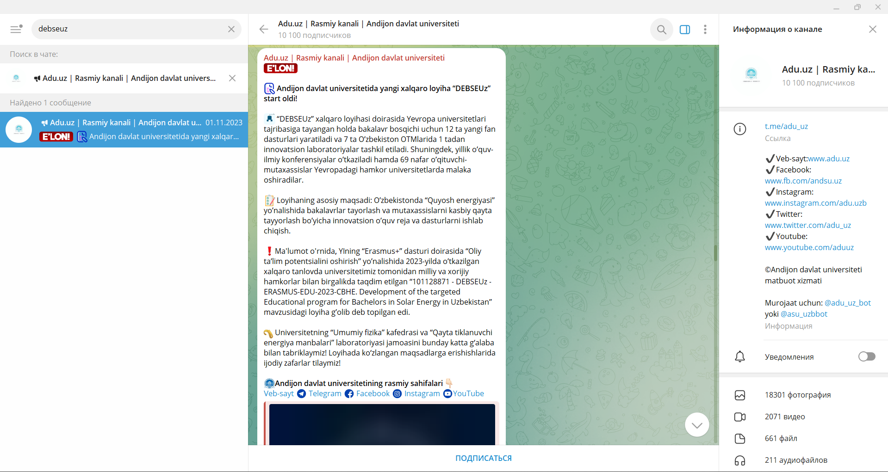
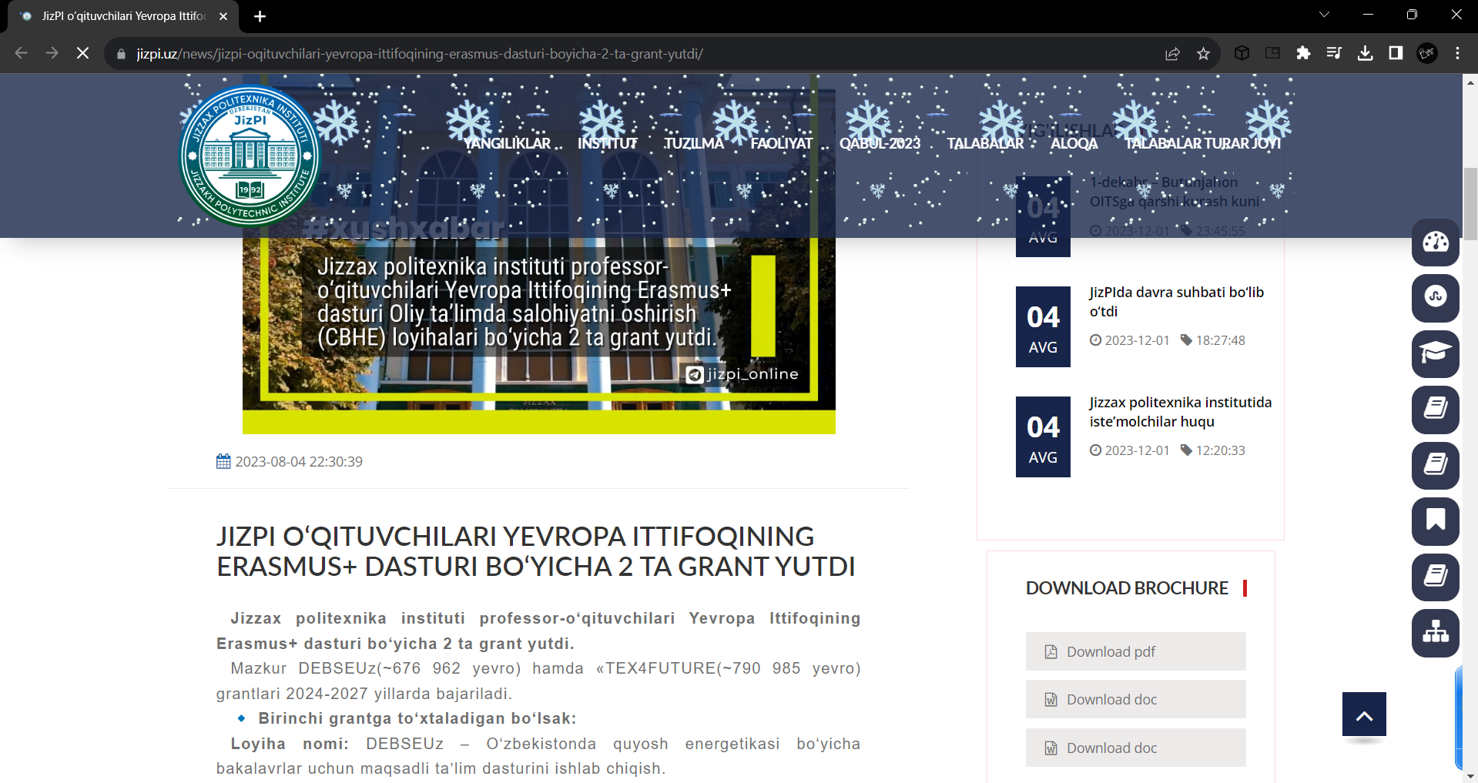
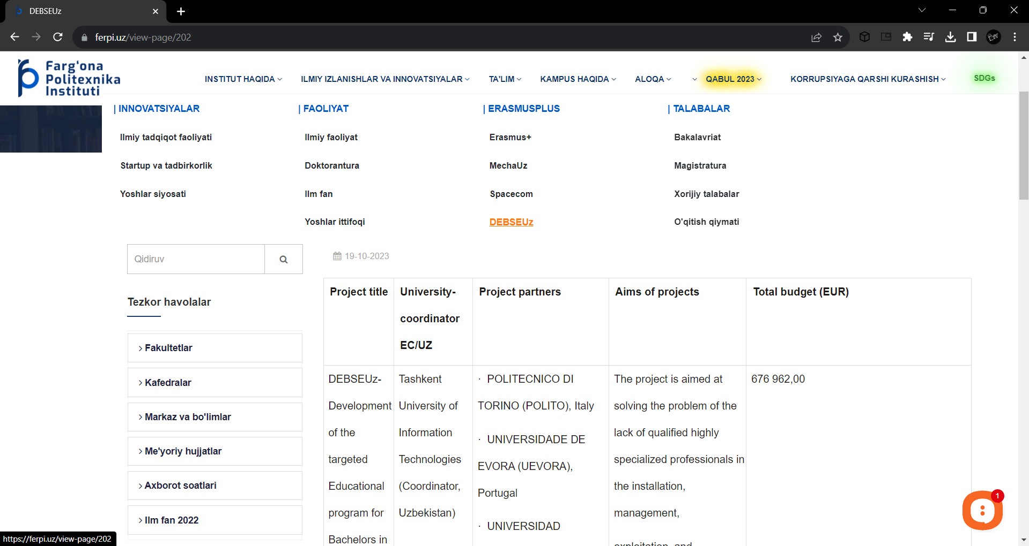
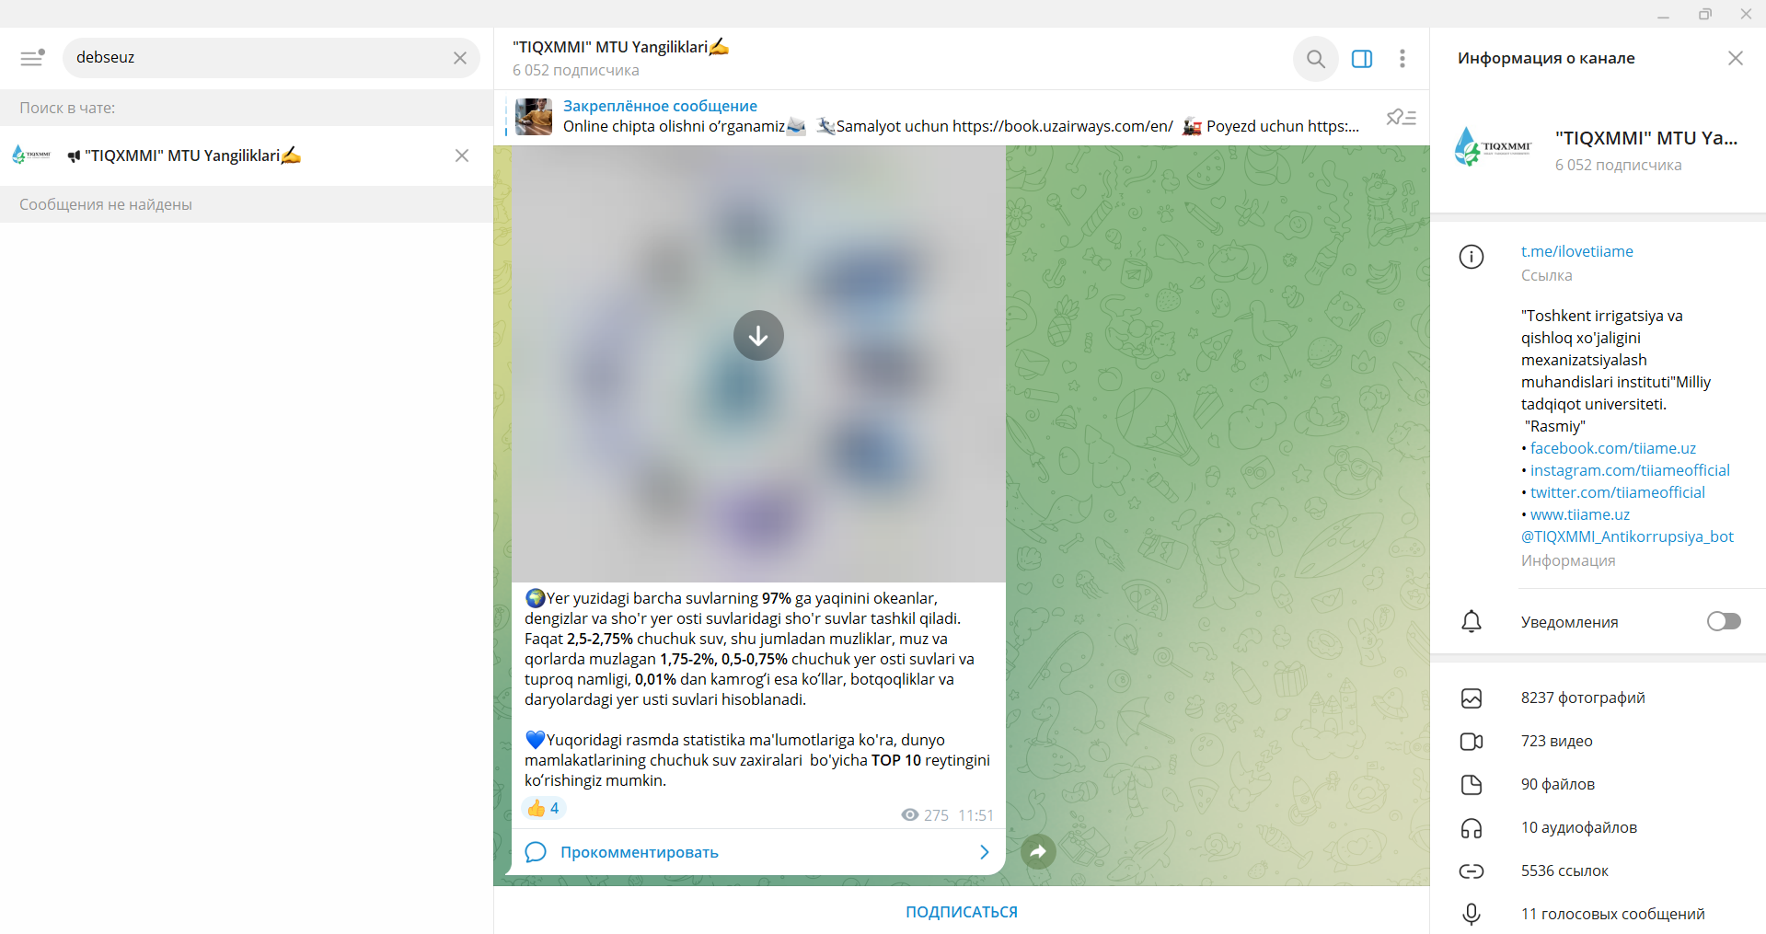
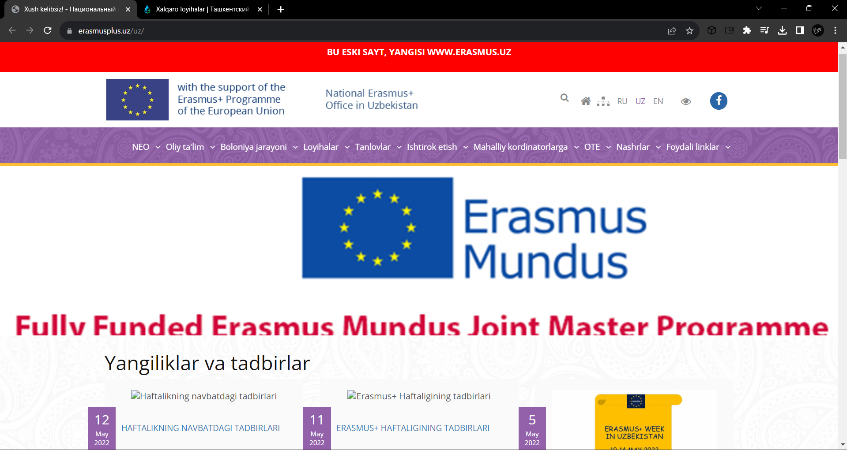
Posts

Slide 18
Thanks for attention
(DEBSEUz): Development of the targeted Educational program for Bachelors in Solar Energy in Uzbekistan
Juraboev Nodirbek Ihtiyorjon ugli

