Slide 1









Development of the targeted Educational program for Bachelors in Solar Energy in Uzbekistan
101128871 — DEBSEUz — ERASMUS-EDU-2023-CBHE
POTENTIAL OF ANDIJAN STATE UNIVERSITY TO CONTRIBUTE TO THE SUCCESS OF THE DEBSEUz PROJECT

Slide 2


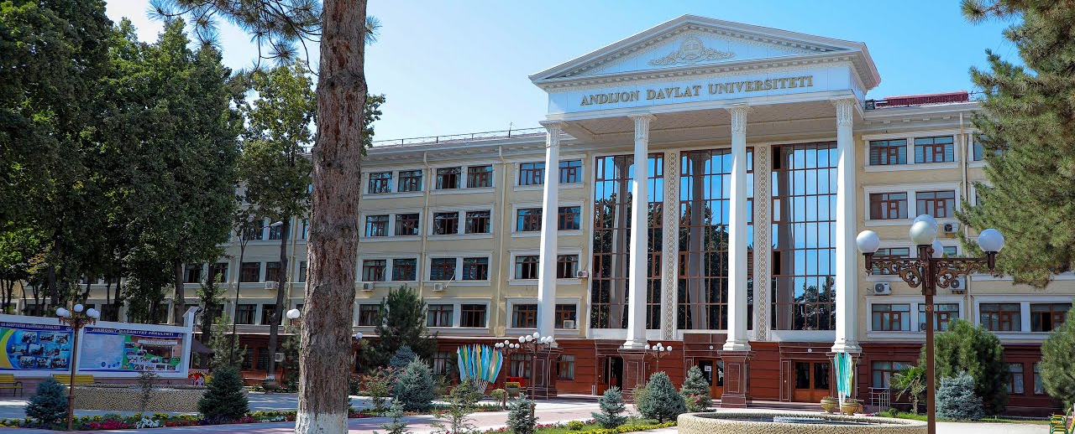
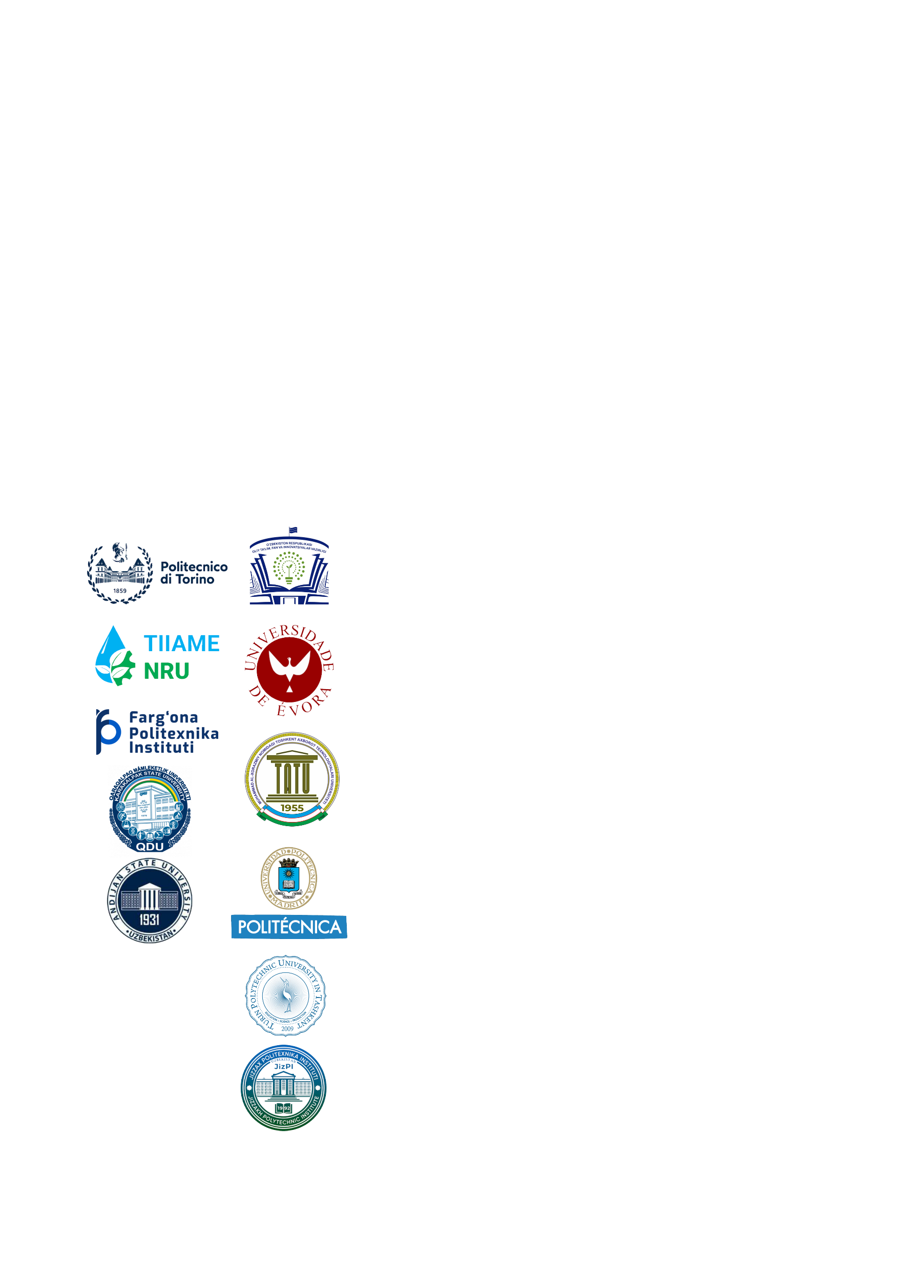

HISTORY OF ANDIJAN STATE UNIVERSITY
Development of the targeted Educational program for Bachelors in Solar Energy in Uzbekistan
101128871 — DEBSEUz — ERASMUS-EDU-2023-CBHE
The history of Andijan state university named after Zahiriddin Muhammad Babur began in 1931 initially as the affiliation of Ferghana Pedagogical Institute. In 1939 it became an Institute of Teachers, then from 1953 it was named as Andijan Pedagogical Institute and on December 28 1992 in accordance with the resolution of the President of the Republic of Uzbekistan, Andijan Pedagogical Institute was reorganized as Andijan State University.

Slide 3
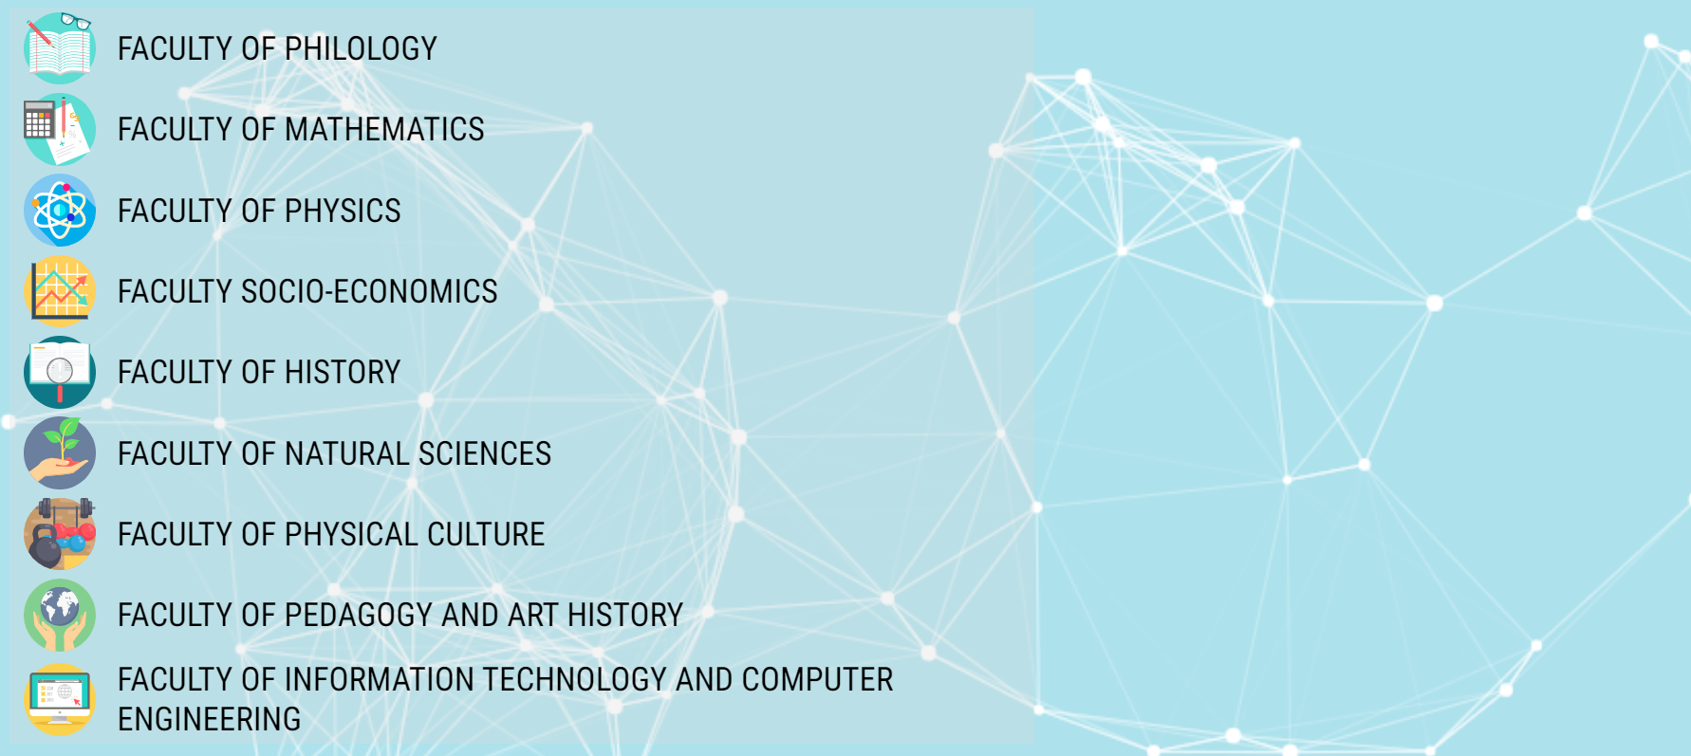
FACULTIES AND DEPARTMENTS OF THE UNIVERSITY
Development of the targeted Educational program for Bachelors in Solar Energy in Uzbekistan
101128871 — DEBSEUz — ERASMUS-EDU-2023-CBHE
Today, 9 faculties and 30 functioning departments are functioning to teach student in 52 specialties at the university.
FACULTIES:
Quality of Academic Staff:
Overall number: 740
Number of DSc: 47
Number of PhD: 205
Number of Professors: 42
Number of Associate Prof. 130
Number of students:
Around 20,000 students

Slide 4

Facilities of the University.
Development of the targeted Educational program for Bachelors in Solar Energy in Uzbekistan
101128871 — DEBSEUz — ERASMUS-EDU-2023-CBHE
Facilities | Area/Buildings/ Rooms | Capacity
Total area of academic facilities including laboratories | 64213 sqm
Lecture rooms | 177 | 12324 seats
Computer rooms | 16 | 450 PCs
Laboratory rooms | 56
Language learning facilities | 8
Dormitories | 4 | 2832 beds
Restaurant/Canteens | 4 | 1050 seats
Sport facilities | 5 sports halls and 15 open sports squares.
Information Resource Center | 450K Paper books, 100K Ebooks

Slide 5
INTERNATIONAL COOPERATIONS OF THE UNIVERSITY
Development of the targeted Educational program for Bachelors in Solar Energy in Uzbekistan
101128871 — DEBSEUz — ERASMUS-EDU-2023-CBHE
Nowadays, ASU has international relations with 17 universities and educational organizations of foreign countries.
Partner universities | Sphere of Cooperation
Riga Technical University | Student mobility, Scientific researches in Natural sciences
Ege University, Turkey | Teaching and academic supervising BSc/MSc/PhD students in Ecology, Botanica, Biology
Euphrosyne Polotskaya State University of Polotsk, Republic of Belarus | Staff/MSc student exchange, Curricula development
Tomsk State University, Russia | Student exchange Curricula development
Indiana University, US | Studying Eurasian history and culture
….

Slide 6
PARTICIPATION OF THE UNIVERSITY IN INTERNATIONAL PROJECTS
Development of the targeted Educational program for Bachelors in Solar Energy in Uzbekistan
101128871 — DEBSEUz — ERASMUS-EDU-2023-CBHE
Nowadays, ASU has rich experience of participating in international projects, including ERASMUS⁺ projects.
Project name | Purpose of the project
TEMPUS: TuCAHEA 2012-2015 | Structural adaptation and improvement of the quality of education of Central HEIs. ASU as a Partner University. Local Coordinator: Ass. Prof. D.Nurmatov
Erasmus+: IQAT 2015-2017 | Improving capacity to implement an institutional system of quality and typology assurance using the principles of the Bologna process. ASU as a Partner University. Local Coordinator: Ass. Prof. D. Nurmatov
Erasmus+: RENES 2016-2019 | Development of Master’s Program in Renewable energy sources and sustainable environment. ASU as a Partner University. National Coordinator: Prof. Aliev R.
Erasmus+: ECAMPUz 2023-2025 | Training professionals and implementing standardized international practices in the area of food science and sustainable food production in Uzbekistan. ASU as a partner university. Local Coordinator: Ass. Prof. D. Nurmatov
Erasmus+: DEBSEUz | Development of the targeted Educational program for Bachelors in Solar Energy in Uzbekistan. ASU as a Partner University. Local Coordinator: Prof. Aliev R.

Slide 7
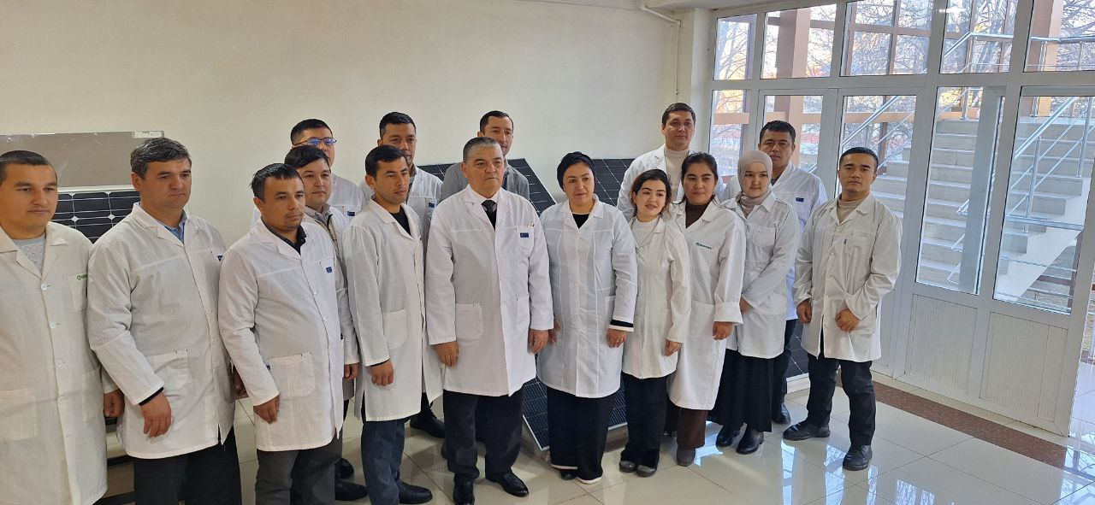
Laboratory of Renewable Energy Sources (RESLAB)
Development of the targeted Educational program for Bachelors in Solar Energy in Uzbekistan
101128871 — DEBSEUz — ERASMUS-EDU-2023-CBHE
RESLAB is the one of the leading research laboratories at the university.
It was organized by Professor Aliev Rayimjon and currently it unified:
1 DSc student, 4 Ph.D graduatees, 11 Ph.D students, 5 MSc students
Research areas of the laboratory:
Solar Energy sources;
Wind Energy Sources;
Mini and Micro Hydro Energy Sources;
Thermal Energy Sources;
Energy Forecasting.

Slide 8
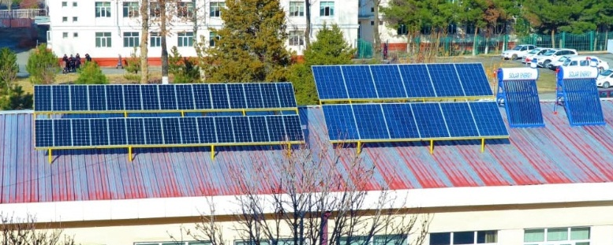
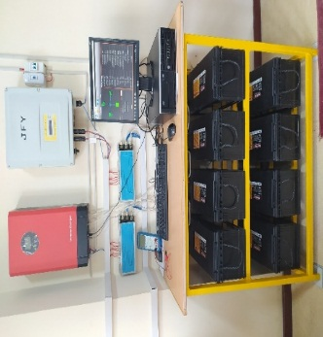
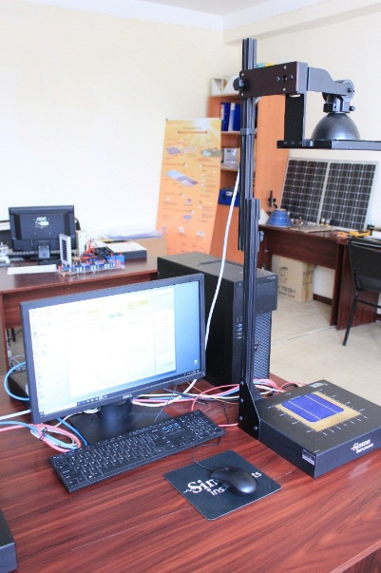
Facilities and activities at RESLAB
Development of the targeted Educational program for Bachelors in Solar Energy in Uzbekistan
101128871 — DEBSEUz — ERASMUS-EDU-2023-CBHE
RESLAB has excellent facilities to study frontier problems in solar, thermal and wind energy sphere.
2 types of solar panels systems with 2x3kW output connected to battery system. Single and multi- crystalline solar panels, installed in 2021 Jan.
Sinton Instruments WCT-120 Lifetime tester system in set.
The equipment allows to study life time of charged particles in silicon.
Sinton Instruments Suns-Voc.
The device allows to study the power, life time, volt-ampere characteristics and other parameters of various silicon-based solar cells.

Slide 9
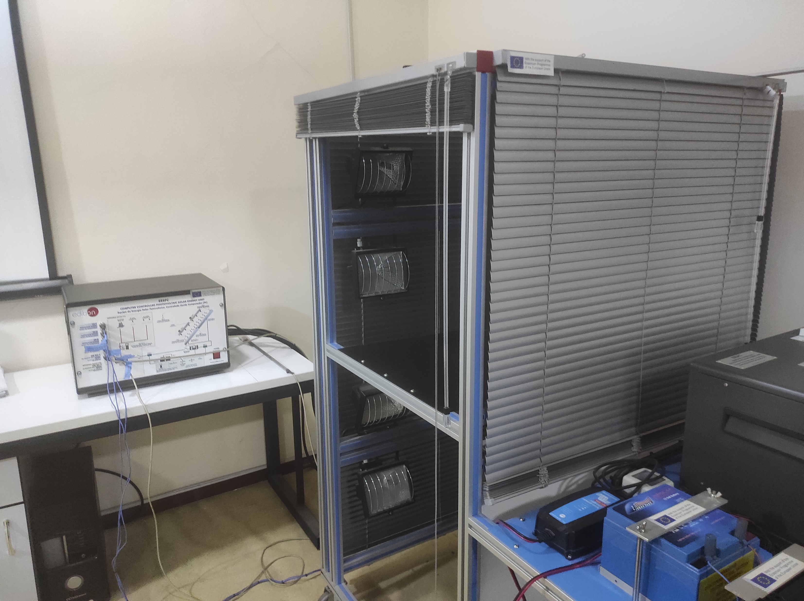
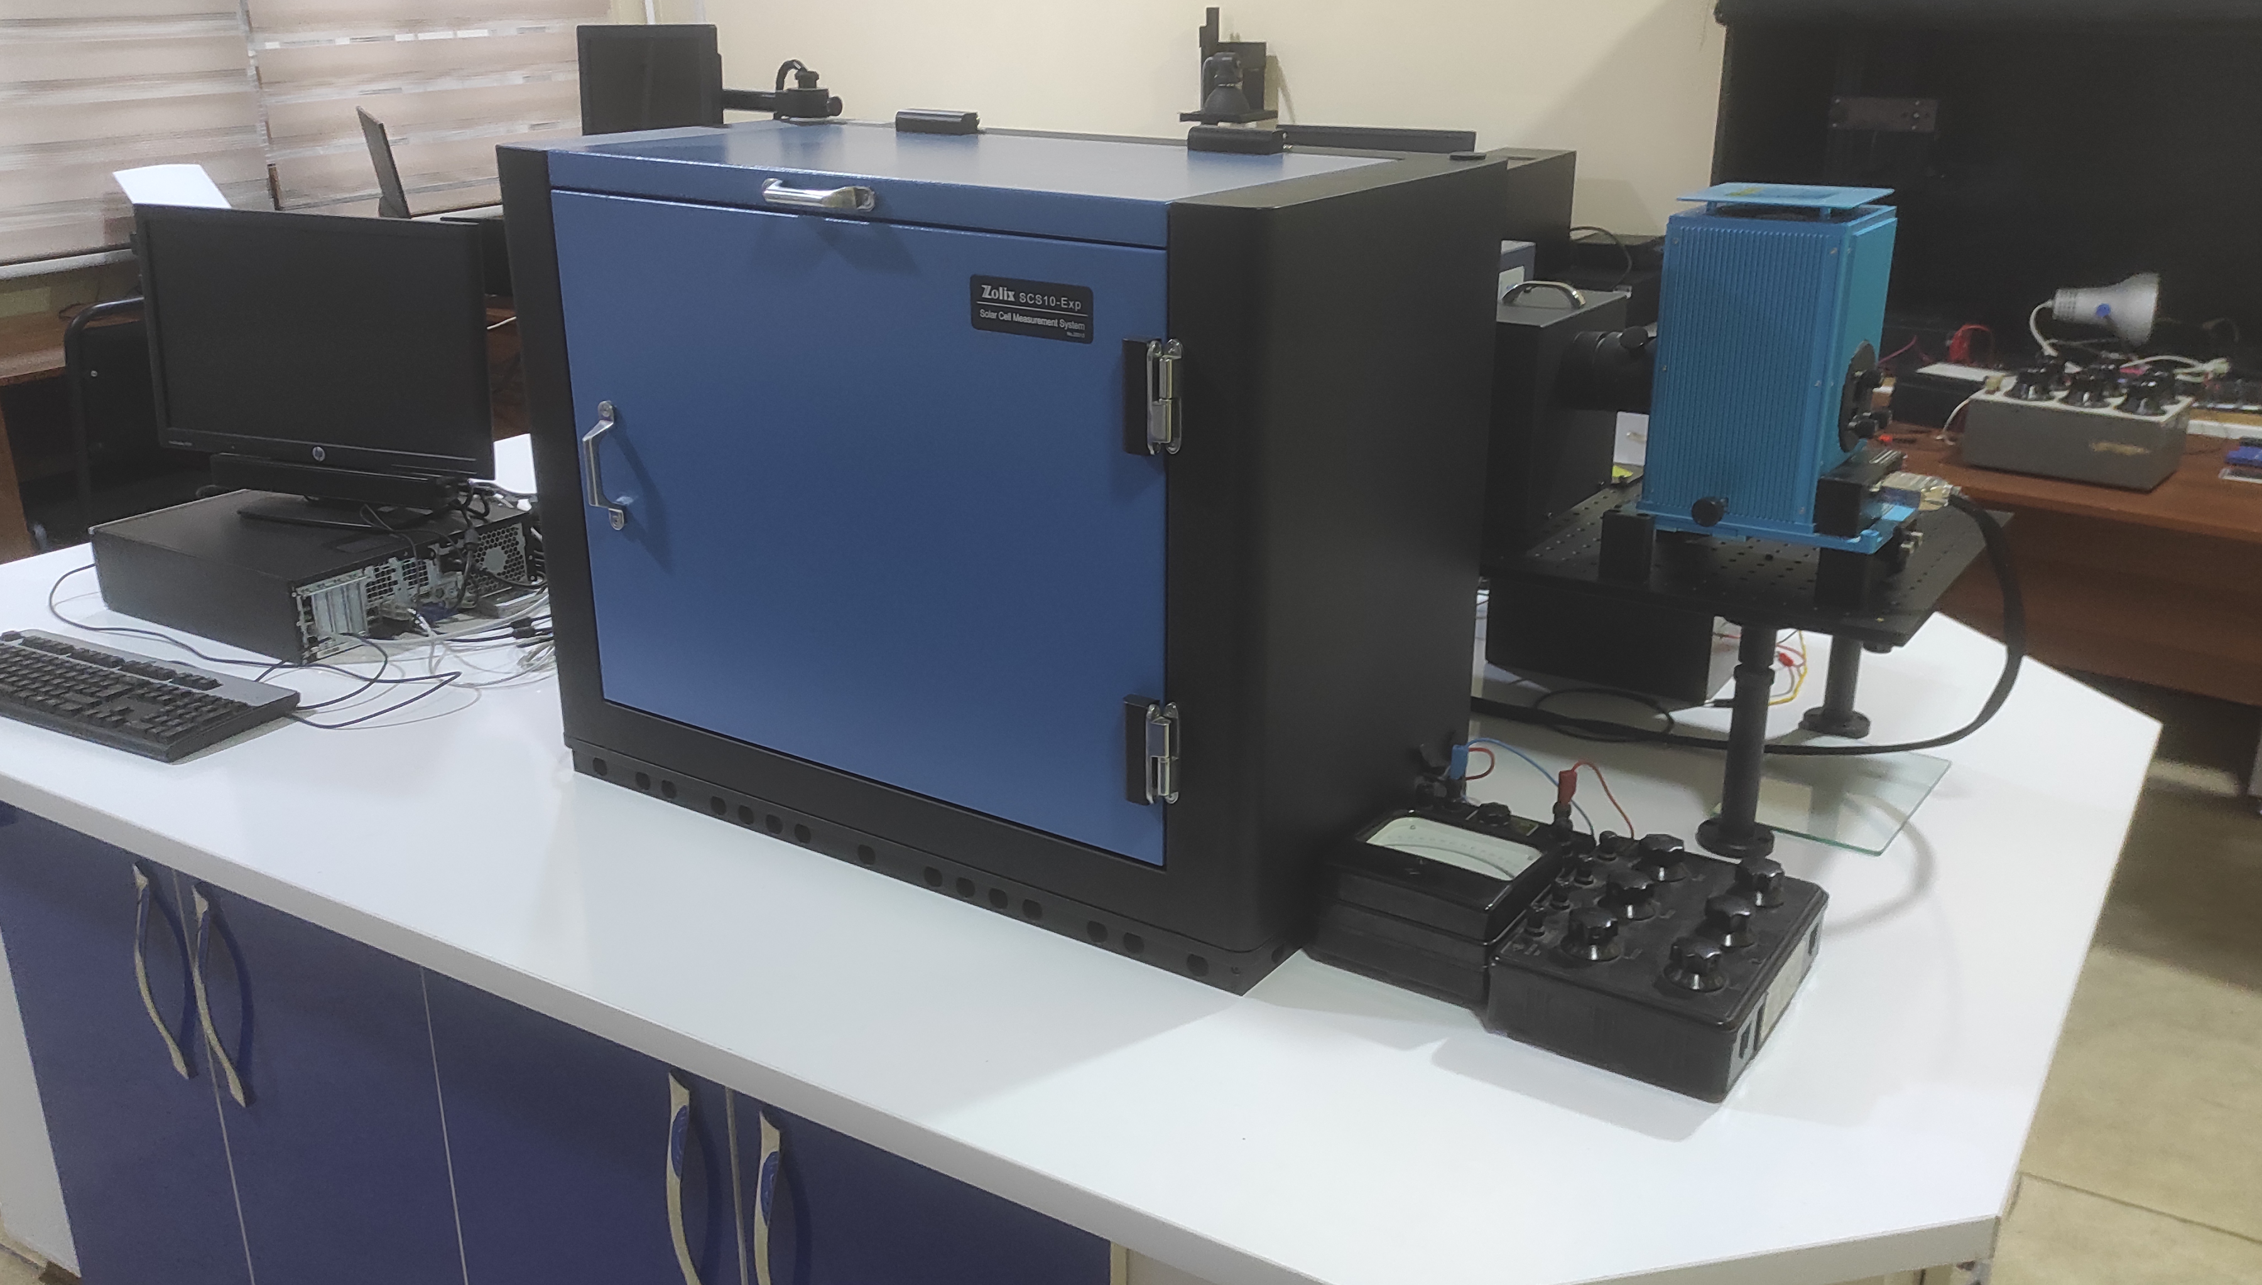
Facilities and activities at RESLAB
Development of the targeted Educational program for Bachelors in Solar Energy in Uzbekistan
101128871 — DEBSEUz — ERASMUS-EDU-2023-CBHE
Deep investigating solar energy issues is the main focus of the RESLAB
EDIBON-SCADA. This device allows to investigate solar panels under various solar irradiance levels connecting solar panels in parallel and series and determining their characteristics according to 31 parameters
Zolix Instruments SCS10-Exp.
A device for measuring the quantum efficiency of various silicon-based solar cells

Slide 10
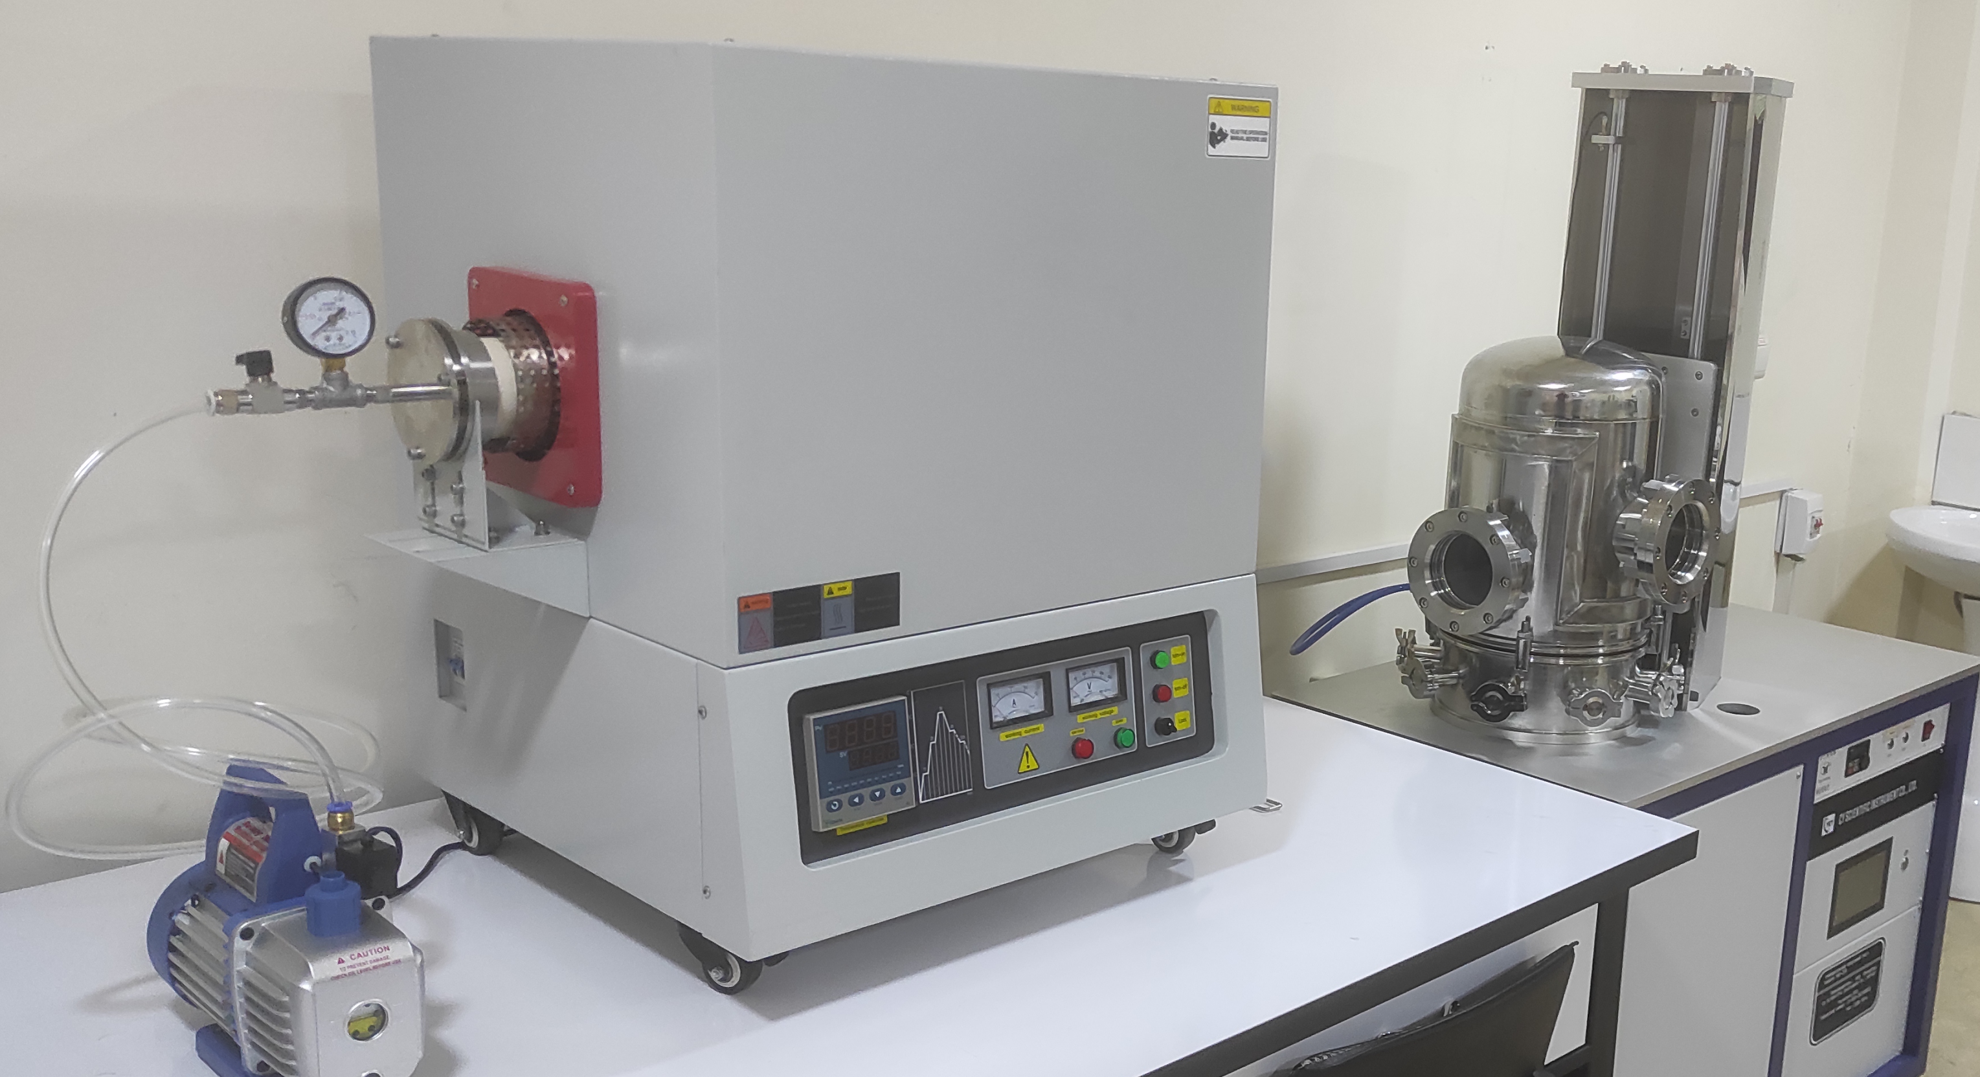
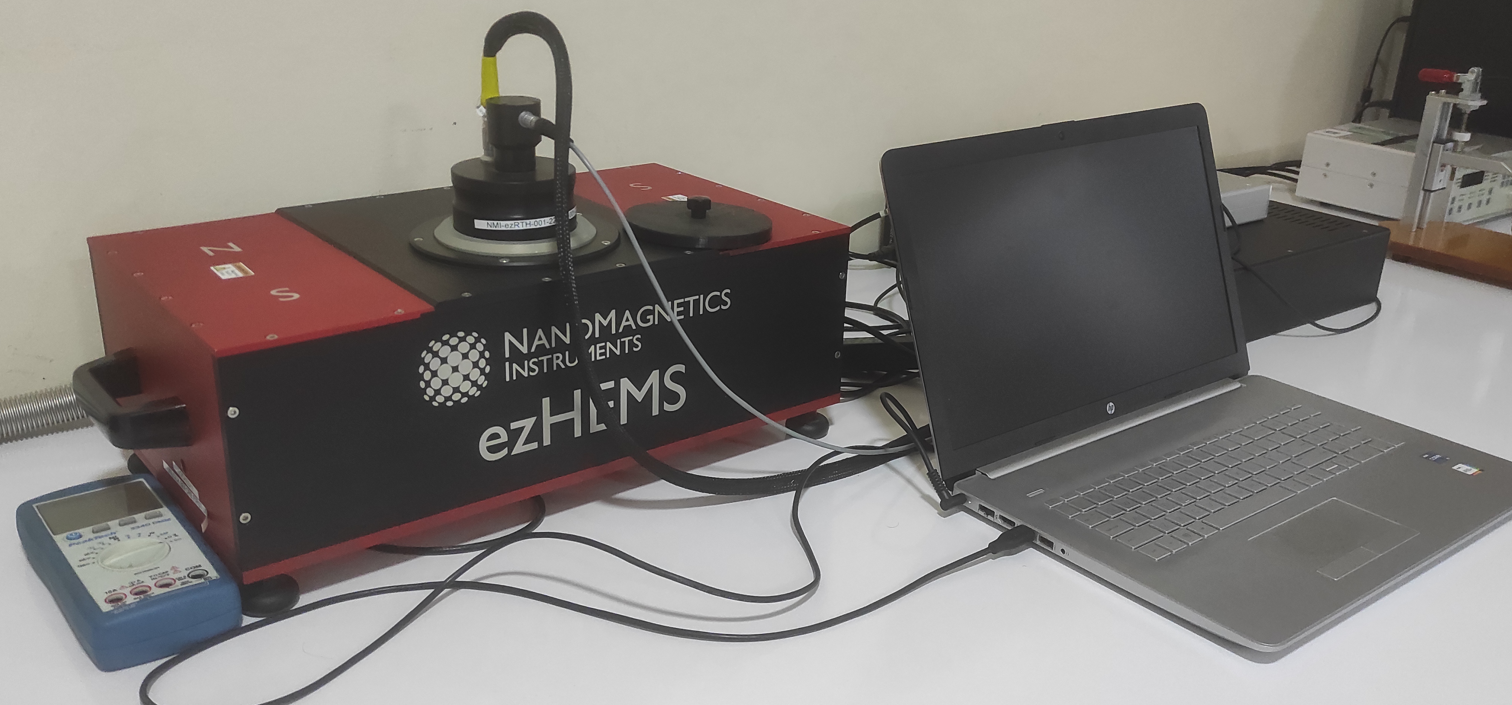
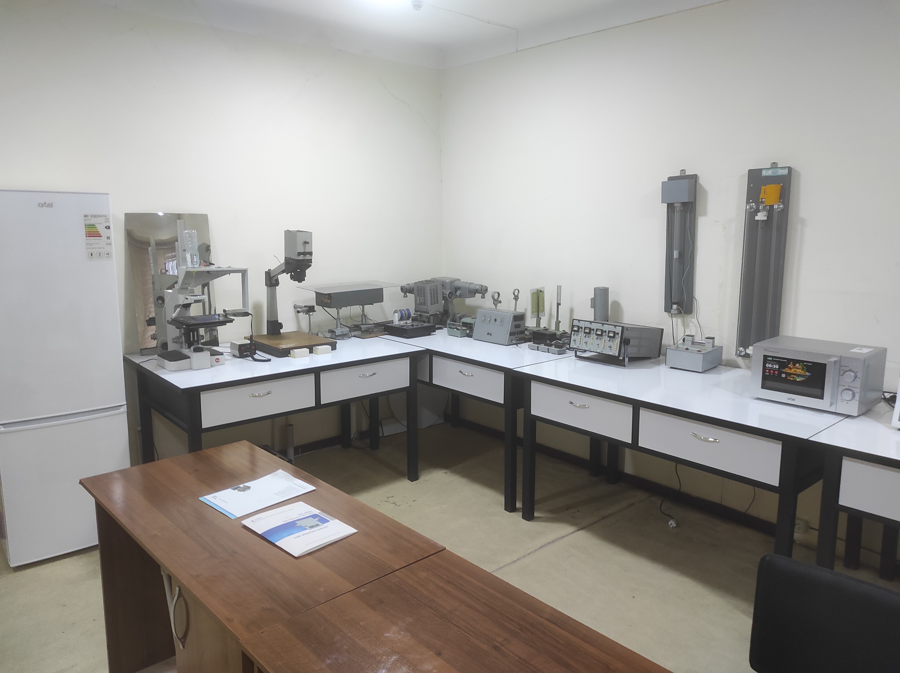
Facilities and activities at RESLAB
Development of the targeted Educational program for Bachelors in Solar Energy in Uzbekistan
101128871 — DEBSEUz — ERASMUS-EDU-2023-CBHE
RESLAB is moving to create new materials to improve solar cell efficiency.
ezHEMS- Hall Effect Measurement Systems.
High temperature furnace & Vacuum coating equipments
These equipments allow to create new materials by coating thin layer of diffused substance under high temperature and vacuum condition.

Slide 11
I am glad to assure you that ASU will do its best to implement the project successfully.
Thank you for your attention!
Development of the targeted Educational program for Bachelors in Solar Energy in Uzbekistan
101128871 — DEBSEUz — ERASMUS-EDU-2023-CBHE

